Slide 2
Microservices

Slide 3
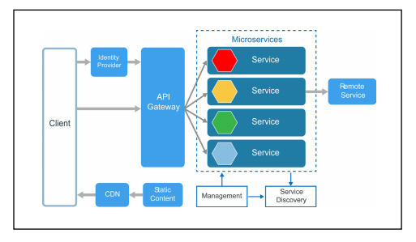

Slide 4
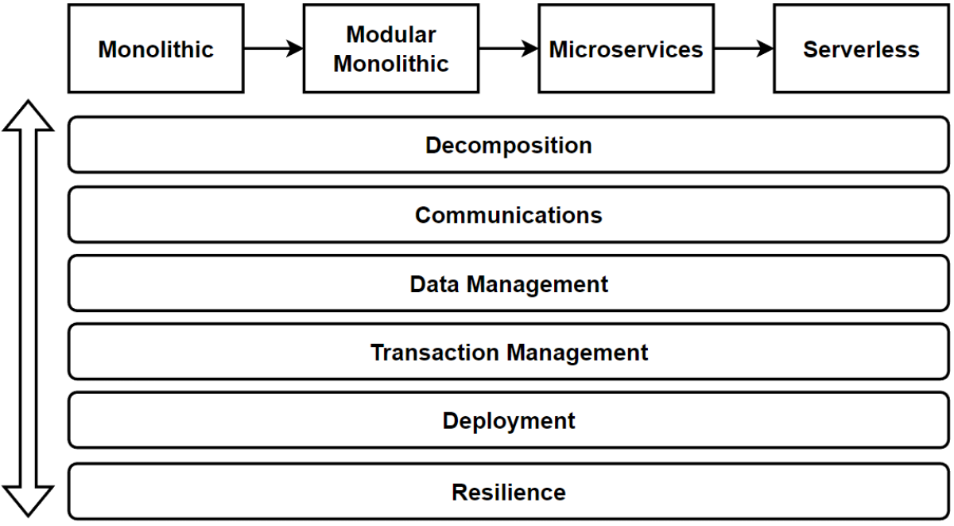
Microservices Decomposition — Breaking Down Microservices
Microservices Communications (Sync / Async Message-Based Communication, API Gws)
Microservices Data Management (Databases / Query / Commands)
Microservices Transaction Management
Microservices Distributed Caching
Microservices Deployments with Containers and Orchestrators
Microservices Resilience with Distributed Logging, Tracing and Health
Microservices Testing; Contract Testing, Integration Testing, E2E Test
Microservices Security; Authentication and Authorization

Slide 5
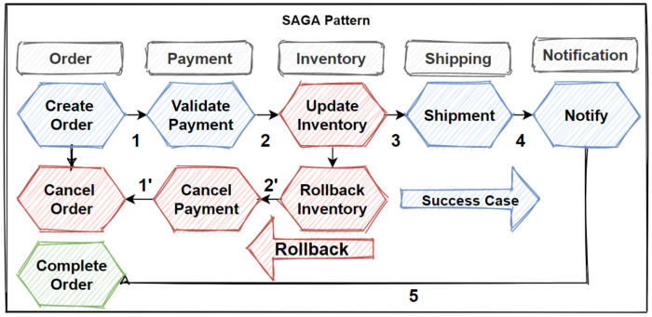

Slide 6
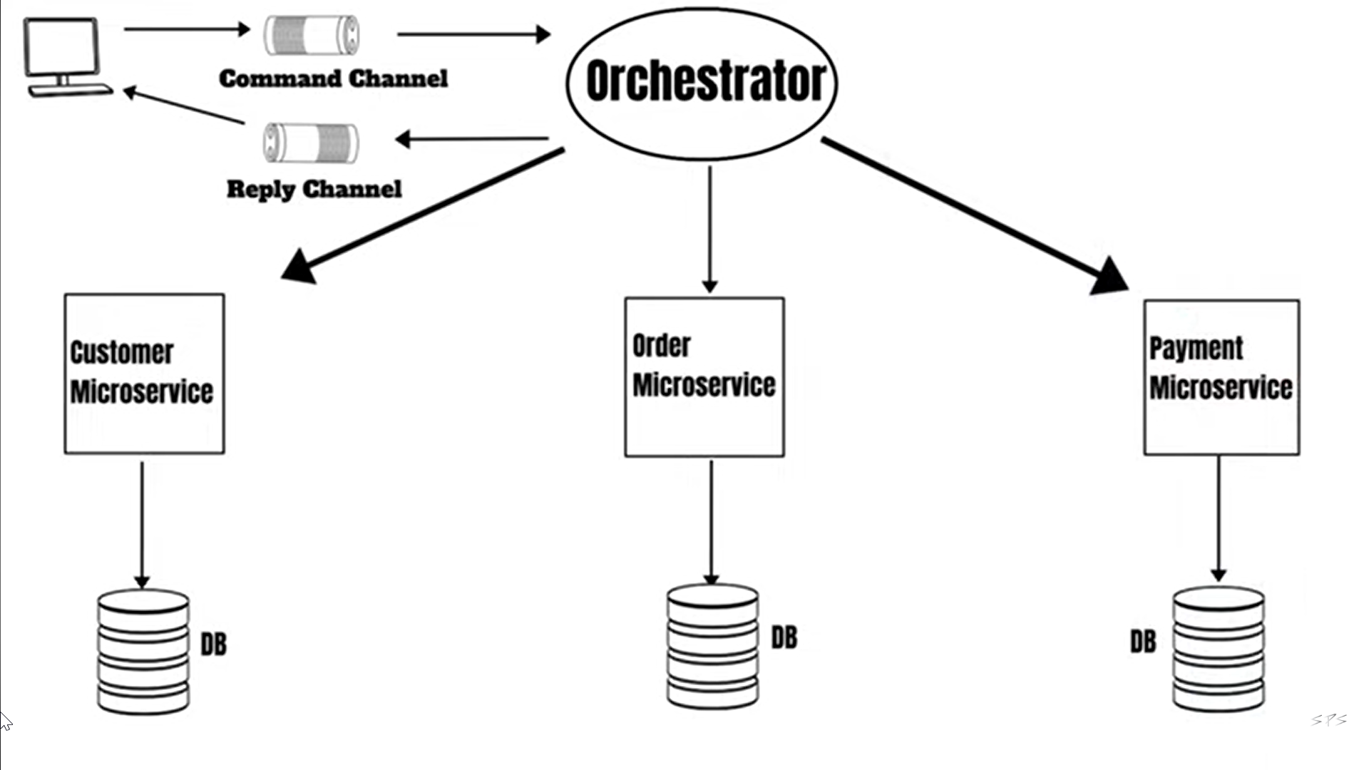

Slide 7
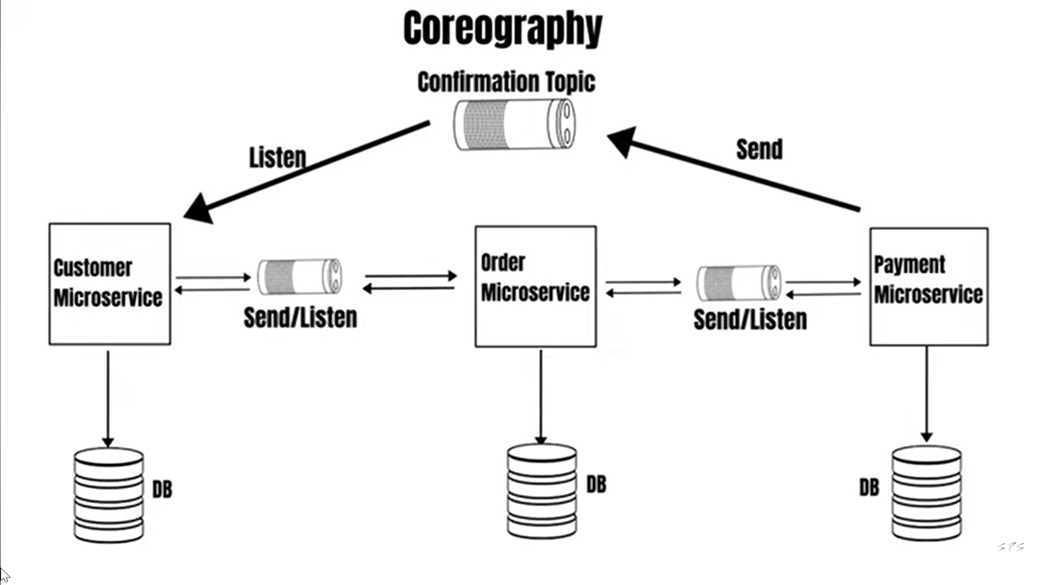

Slide 8
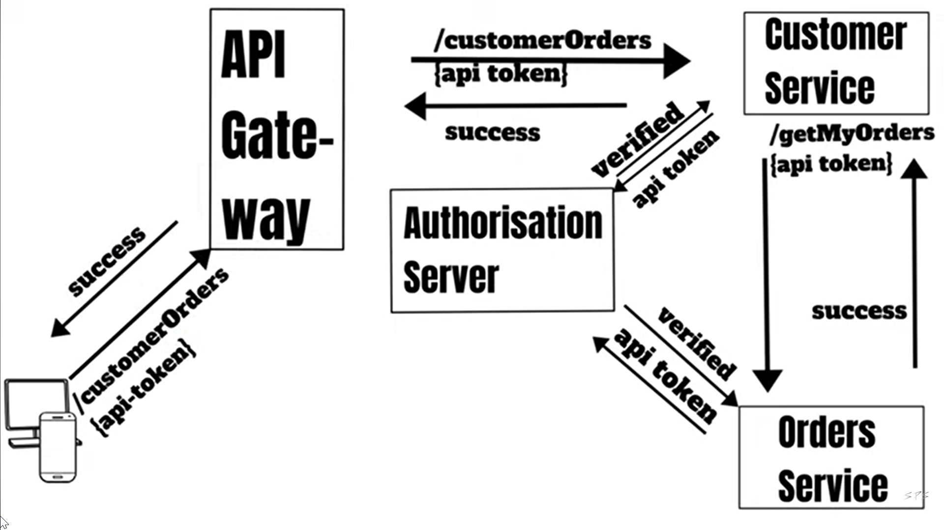

Slide 9
Deign pattern & Principles
Database per Service Pattern
Gateway Routing Pattern
Gateway Aggregation Pattern
Gateway Offloading Pattern
Circuit Breaker Pattern(Closed, Open, Half Open)
SAGA Pattern (Choreography , Orchestration)
Mediator & CQRS Design Pattern
API Gateway Pattern
Backends for Frontends Pattern
Service Aggregator Pattern
Service Registry Pattern
Event Sourcing Pattern
Materialized View Pattern

Slide 10
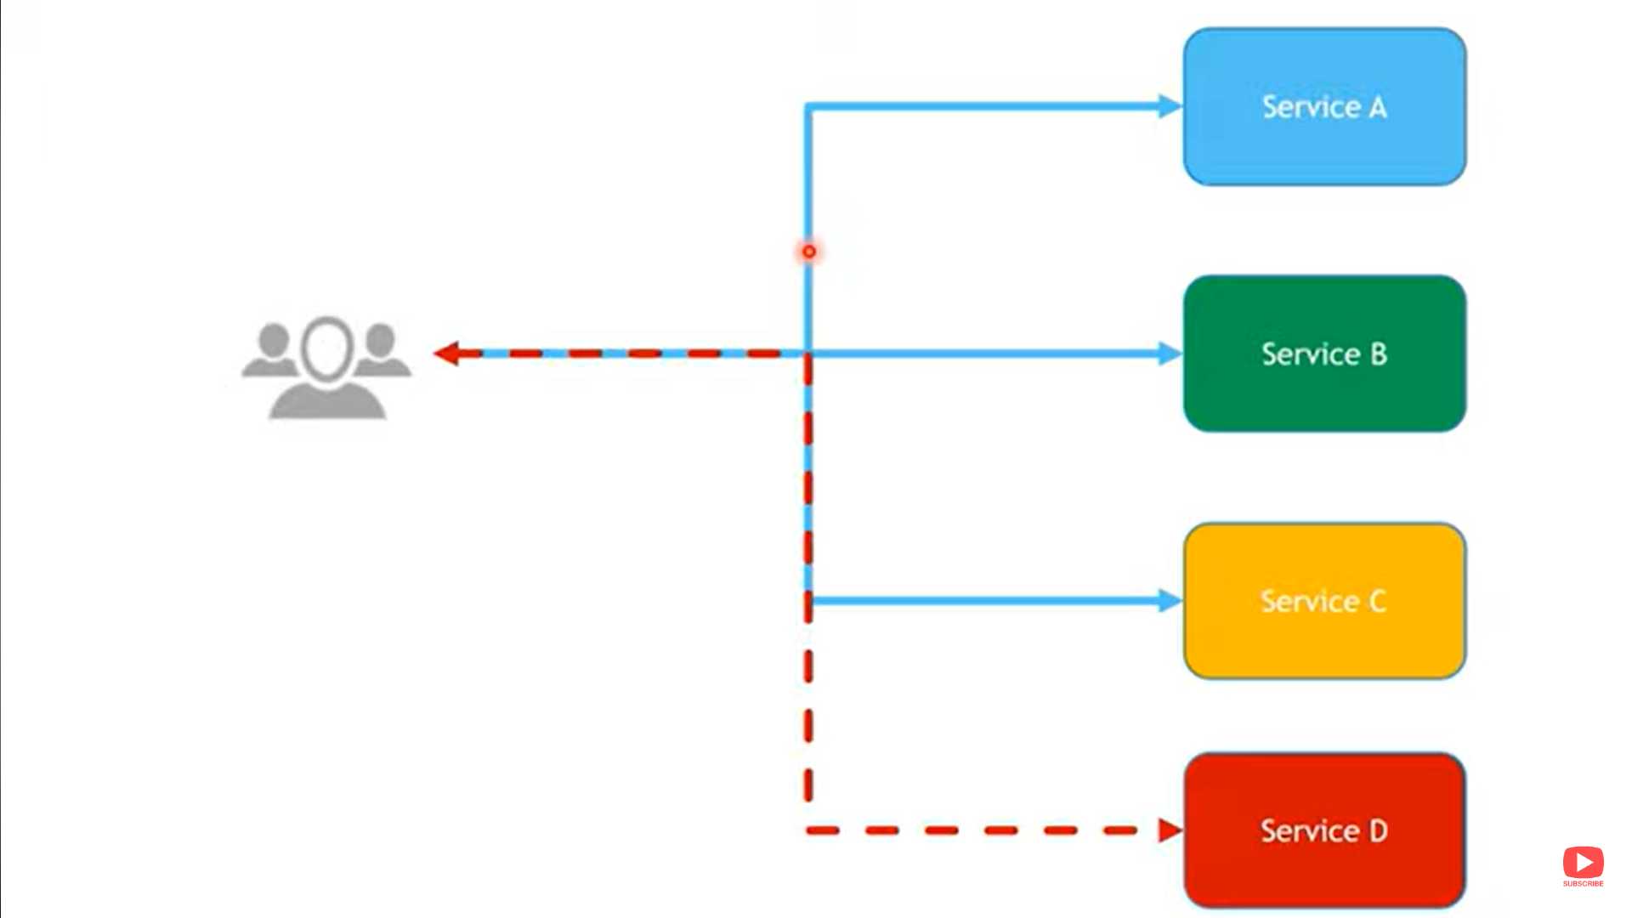
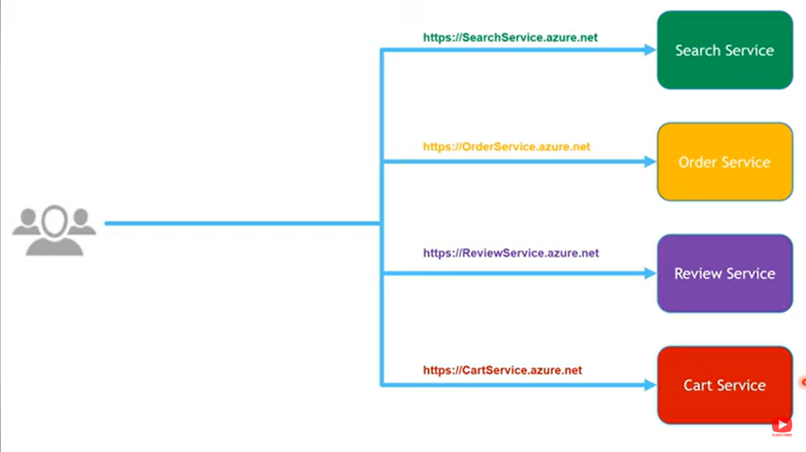
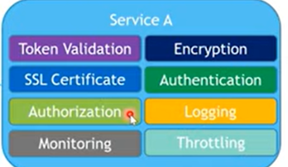
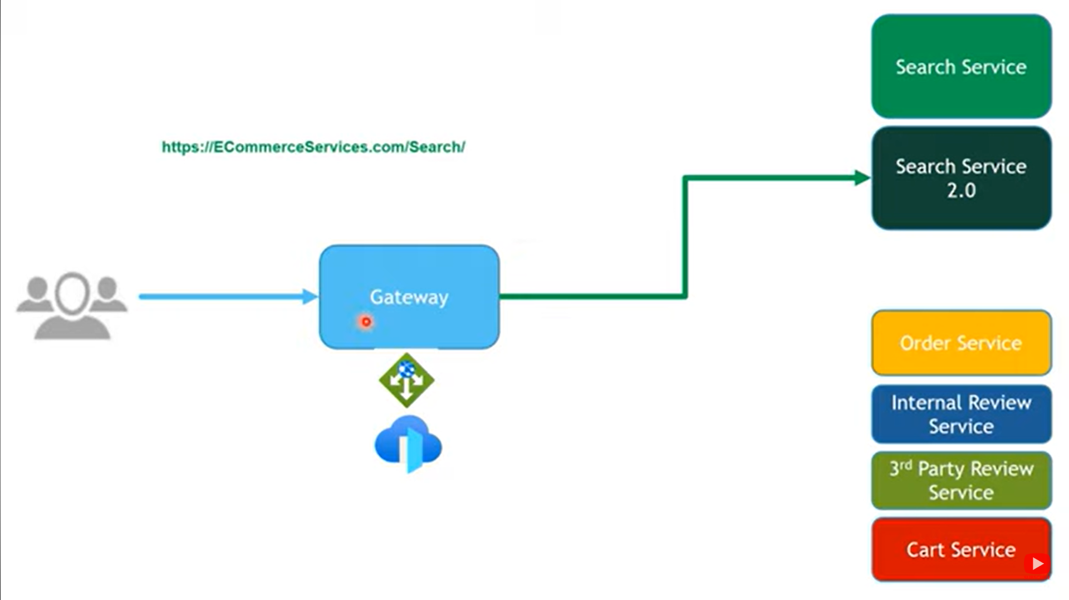
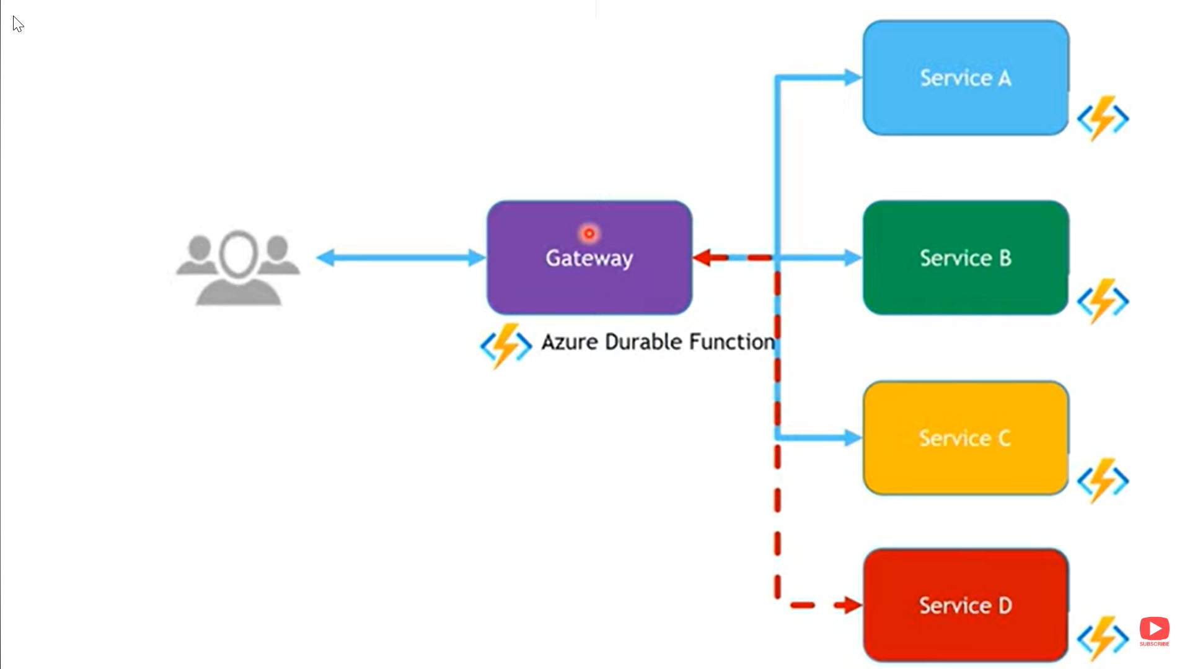
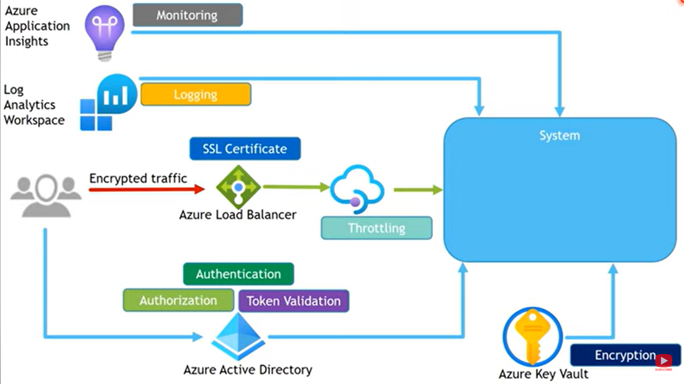
Gateway Aggregator Pattern
Gateway offloading
Gateway Routing Pattern (Define Routing Rules)

Slide 11
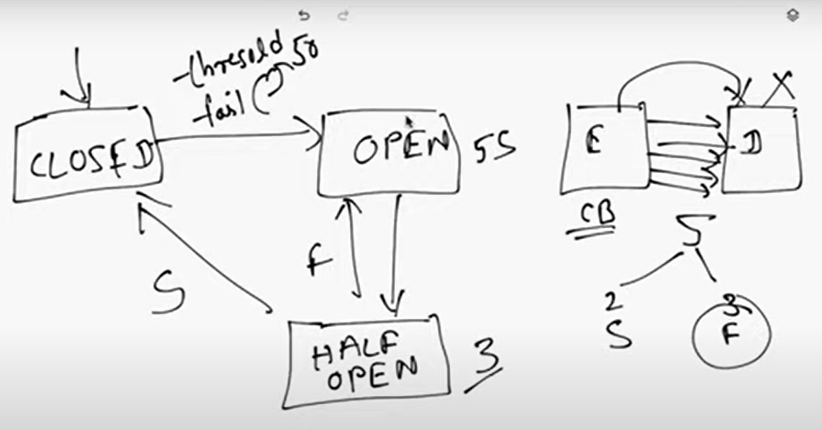
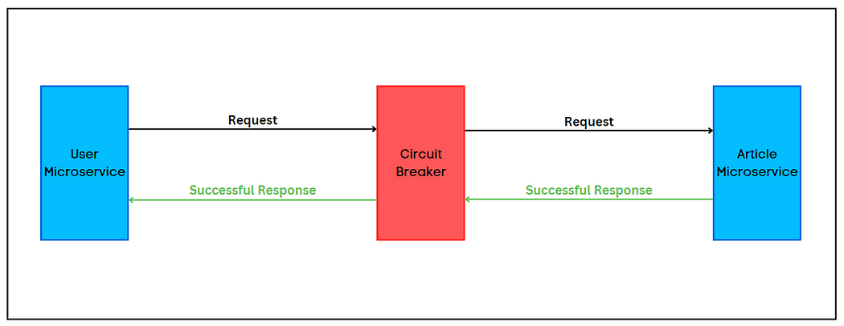
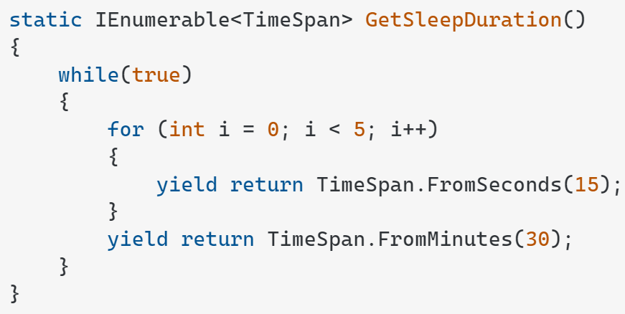
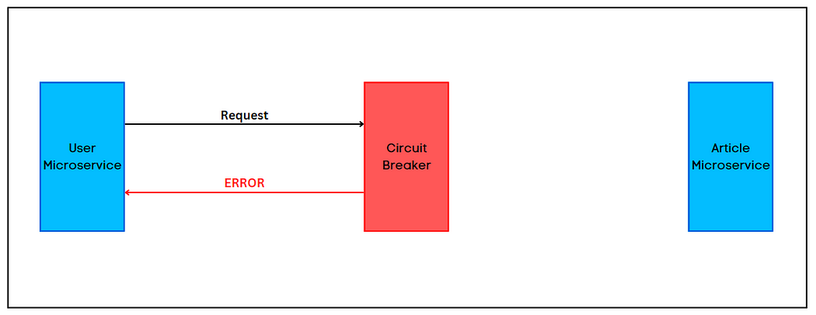
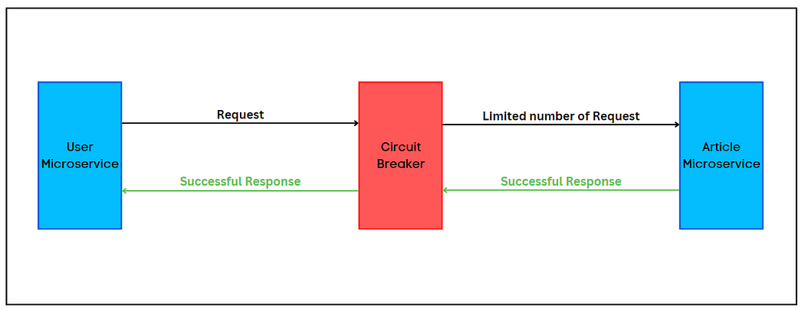
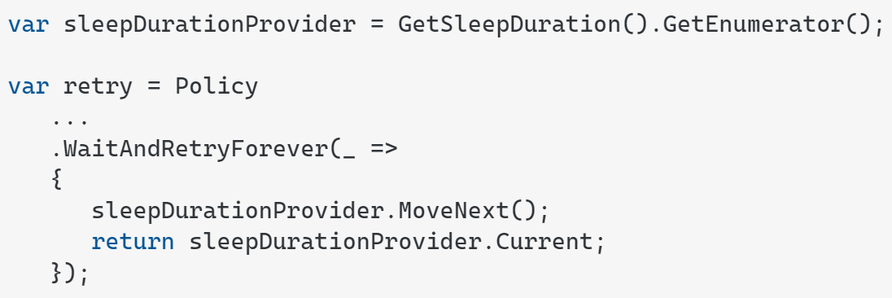
Closed,Open
Half Open

Slide 12
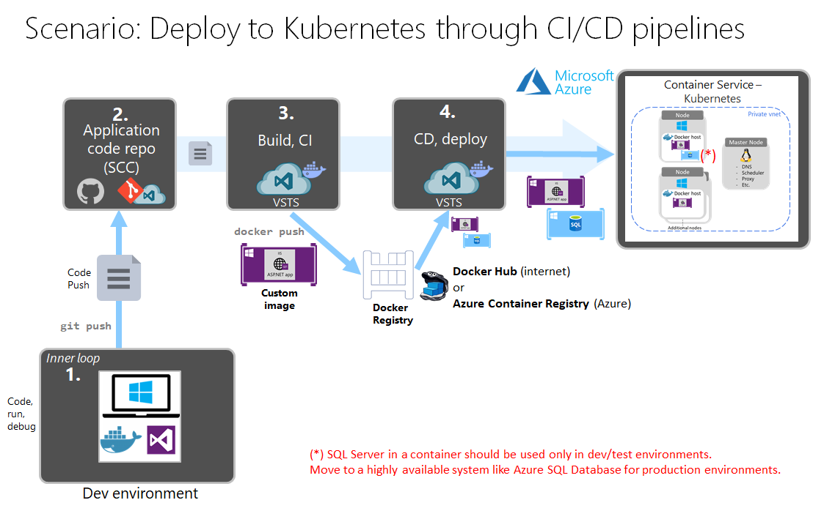

Slide 13
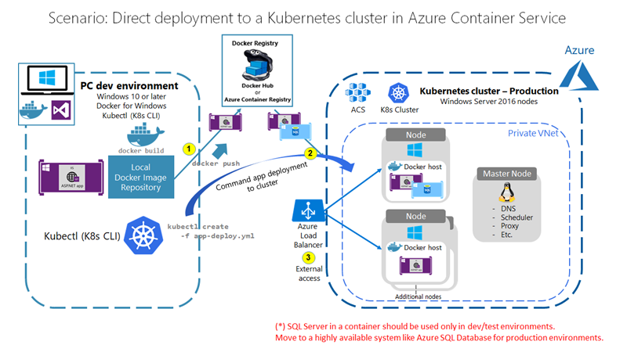

Slide 14
A user makes a request to the application endpoint from the internet.
Azure Application Gateway receives traffic as HTTPS and presents a PFX certificate previously loaded from Azure Key Vault to the user.
Application Gateway uses private keys to decrypt traffic (SSL offload), performs web application firewall inspections, and re-encrypts traffic by using public keys (end-to-end encryption).
Application Gateway applies rules and backend settings based on the backend pool and sends traffic to the API Management backend pool over HTTPS.
API Management is deployed in internal virtual network mode (Developer or Premium tier only) with a private IP address. It receives traffic as HTTPS with custom domain PFX certificates.
Azure Active Directory (Azure AD) provides authentication and applies API Management policies via OAuth and client certificate validation. To receive and verify client certificates over HTTP/2 in API Management, you need to enable Negotiate client certificate on the Custom domains blade in API Management.
API Management sends traffic via HTTPS to an ingress controller for an AKS private cluster.
The AKS ingress controller receives the HTTPS traffic and verifies the PEM server certificate and private key. Most enterprise-level ingress controllers support mTLS. Examples include NGINX and AGIC.
The ingress controller processes TLS secrets (Kubernetes Secrets) by using cert.pem and key.pem. The ingress controller decrypts traffic by using a private key (offloaded). For enhanced-security secret management that's based on requirements, CSI driver integration with AKS is available.
The ingress controller re-encrypts traffic by using private keys and sends traffic over HTTPS to AKS pods. Depending on your requirements, you can configure AKS ingress as HTTPS backend or passthrough.

Slide 15
Azure Bastion
Microsoft Sentinel – (SEIM Security Event and Incident Management
, SOAR -Security Orchestration, Automation and Response)
Microsoft Defender for cloud
Azure Monitor
Application Insight
Log Analytics
Private EndPoints
Azure DevOps Build & Release CICD Pipeline

Slide 16
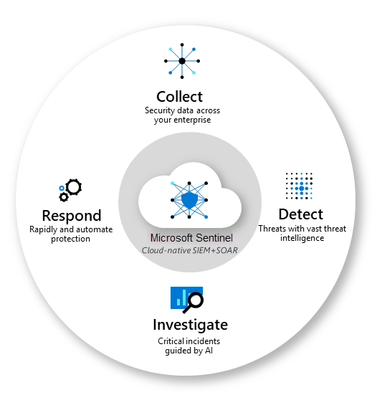
Azure Sentinel

Slide 17
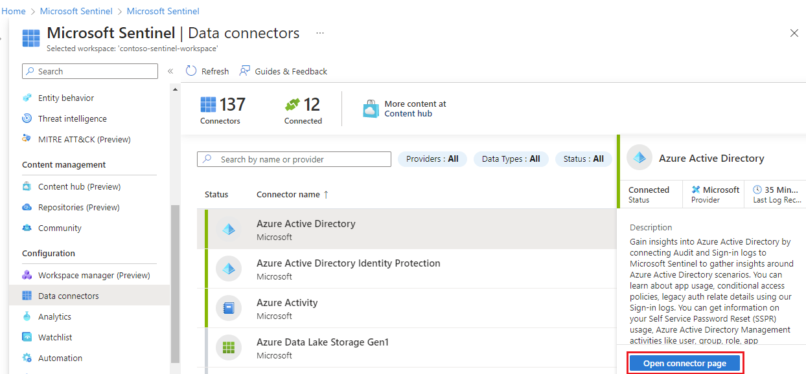

Slide 18
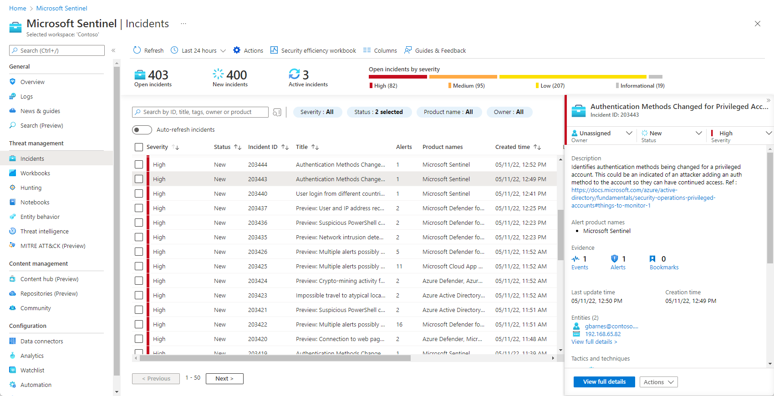
Notes:
https://learn.microsoft.com/en-us/azure/sentinel/overview

Slide 19
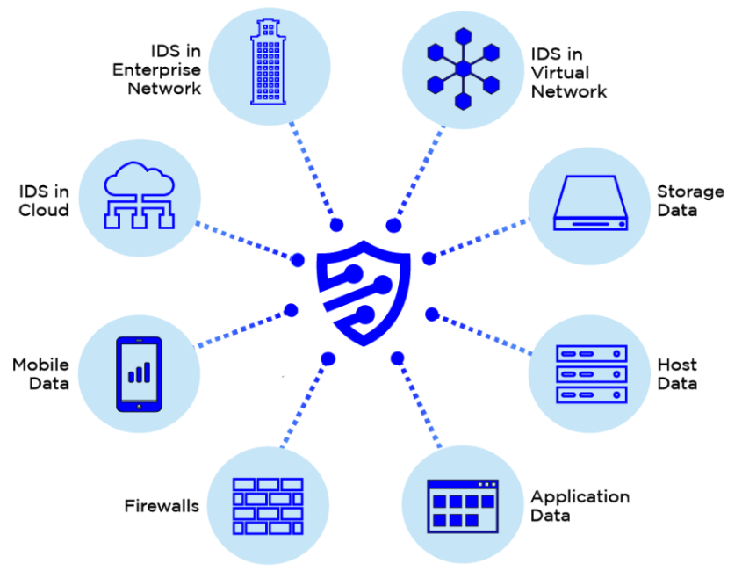
Azure Sentinel: Security Event and Incident Management (SEIM)
Refers to cyber security products and services that provide real time analysis, monitoring, and alerting on security logs and generated by applications, hosts, and network devices. SEIM solutions do this by collecting these disparate logs, normalizing the data, and running the logs entries through complicated algorithms that tease out interesting patterns of behaviors that require human research and confirmation. SEIM solutions are purchased as software, appliance, or managed services solutions.

Slide 20
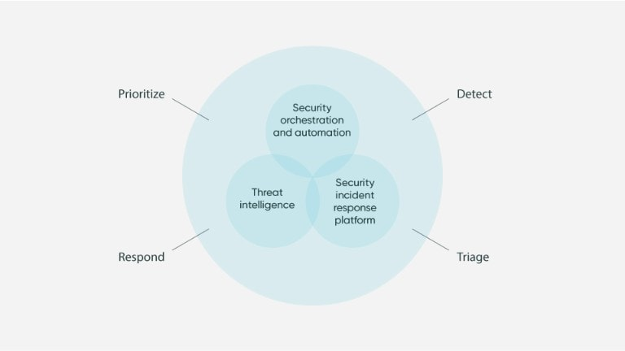
Azure Sentinel: Security orchestration, automation, and response (SOAR)
Security orchestration, automation, and response (SOAR) primarily focuses on threat management, security operations automation, and security incident responses. SOAR platforms can instantly assess, detect, intervene, or search through incidents and processes without the consistent need for human interaction.

Slide 21
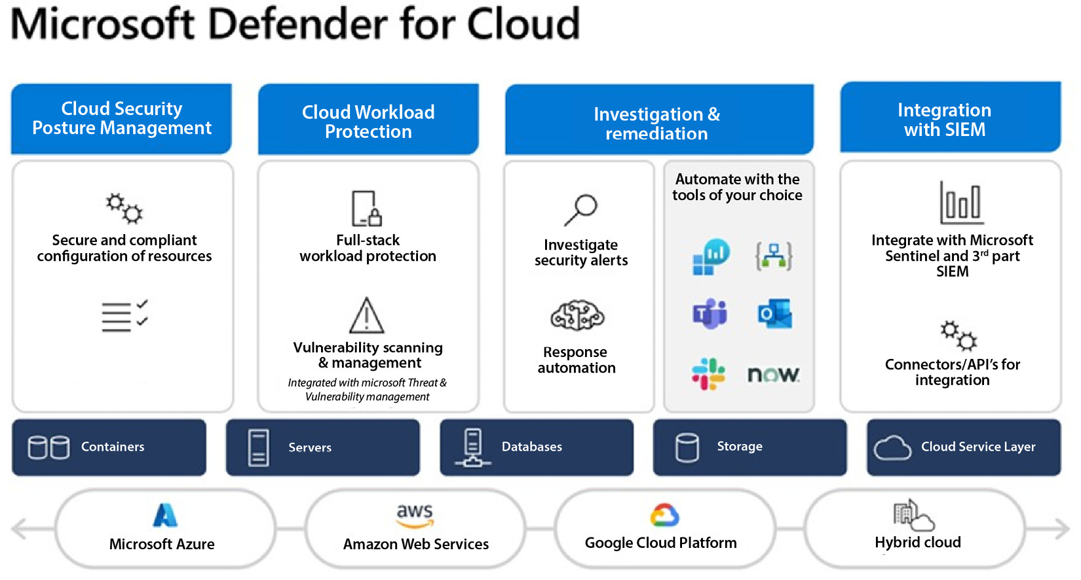

Slide 22
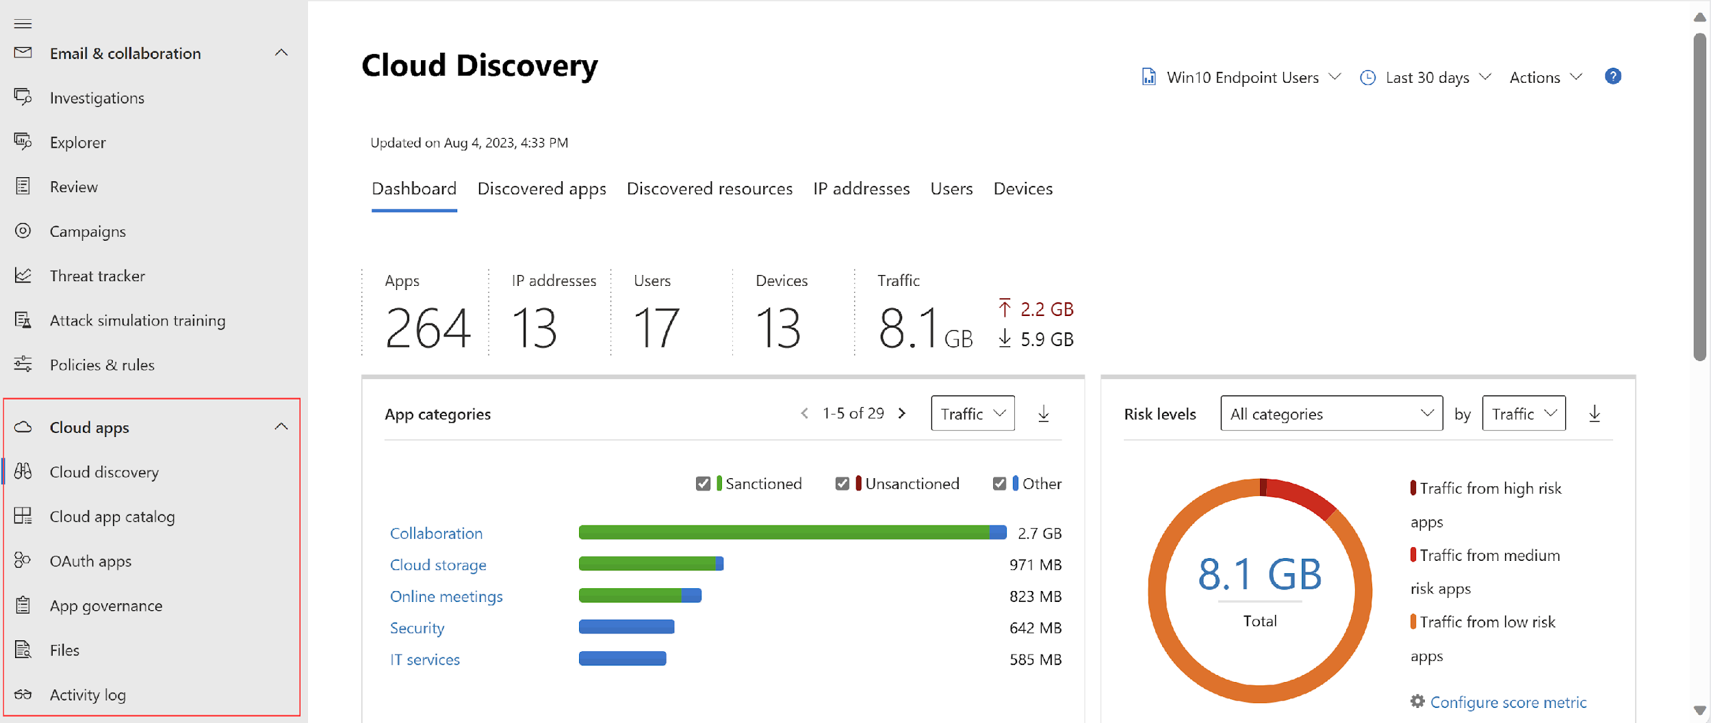

Slide 23
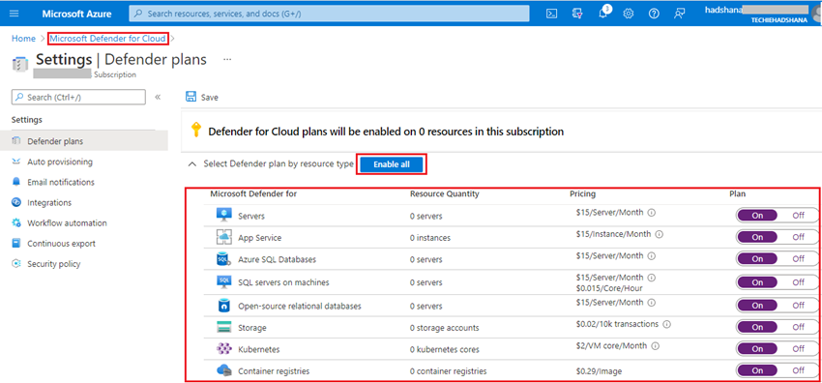
Notes:
https://www.c-sharpcorner.com/article/how-to-enable-microsoft-defender-for-all-the-azure-subscriptions-on-cloud/

Slide 24
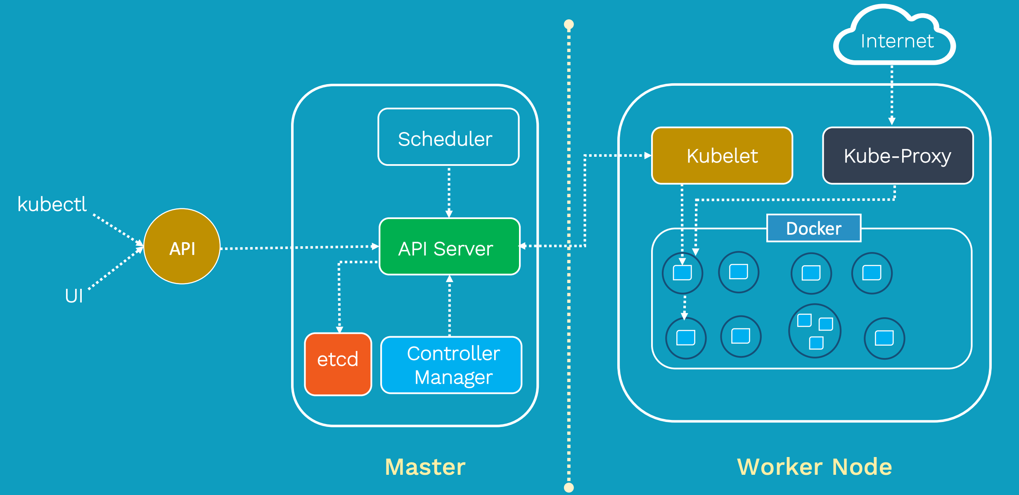
Kubernetes, also known as K8s, is an open-source system for automating deployment, scaling, and management of containerized applications.
Master Node
API Server
Control Manager
Scheduler
etcd
Worker Node
Kubelet
Kube- Proxy
Container Runtime engine
(Docker)

Slide 25
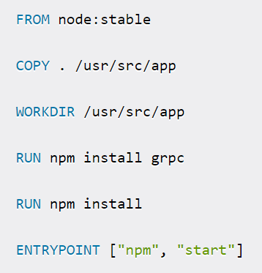

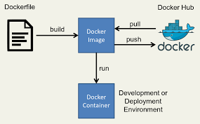
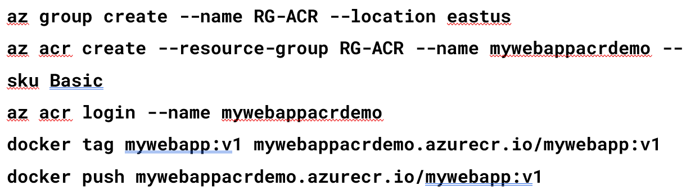
Docker
Docker Build -t,
Docker run
Docker Tag
Docker Push

Slide 26
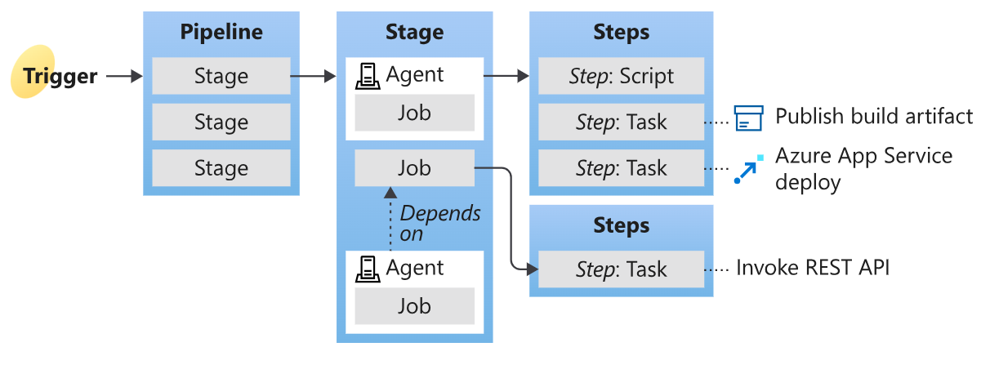

Slide 27
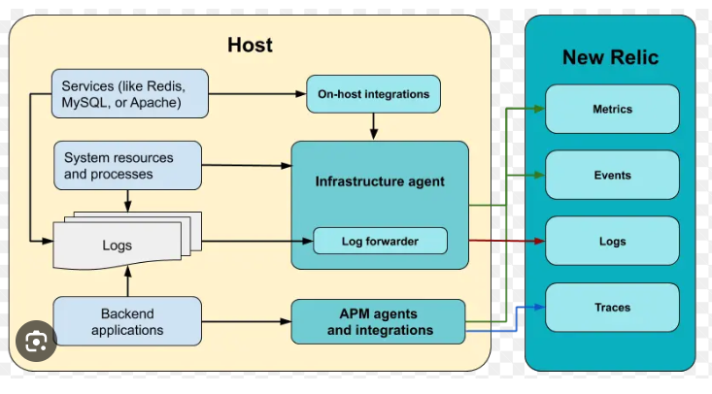
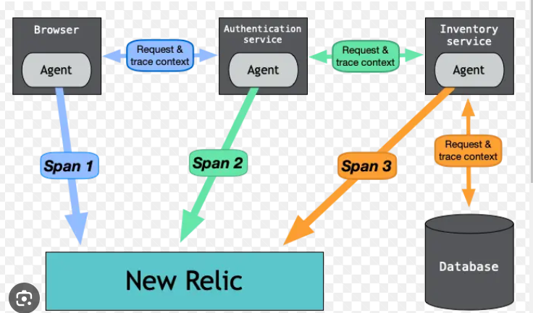

Slide 28
Microservice Logging (Azure, AWS)

Slide 29
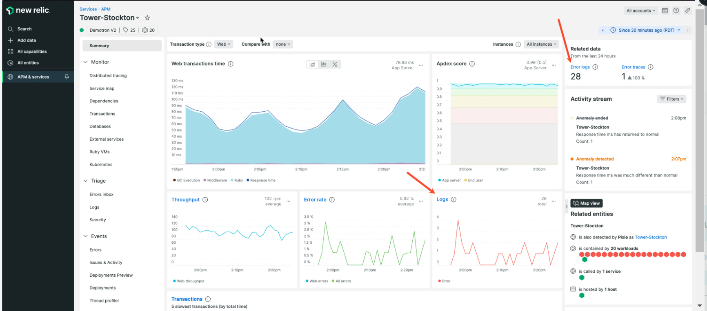

Slide 30
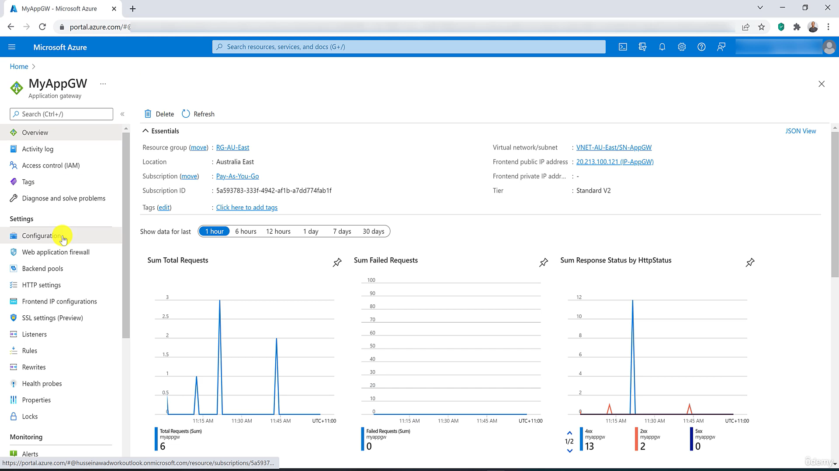

Slide 31
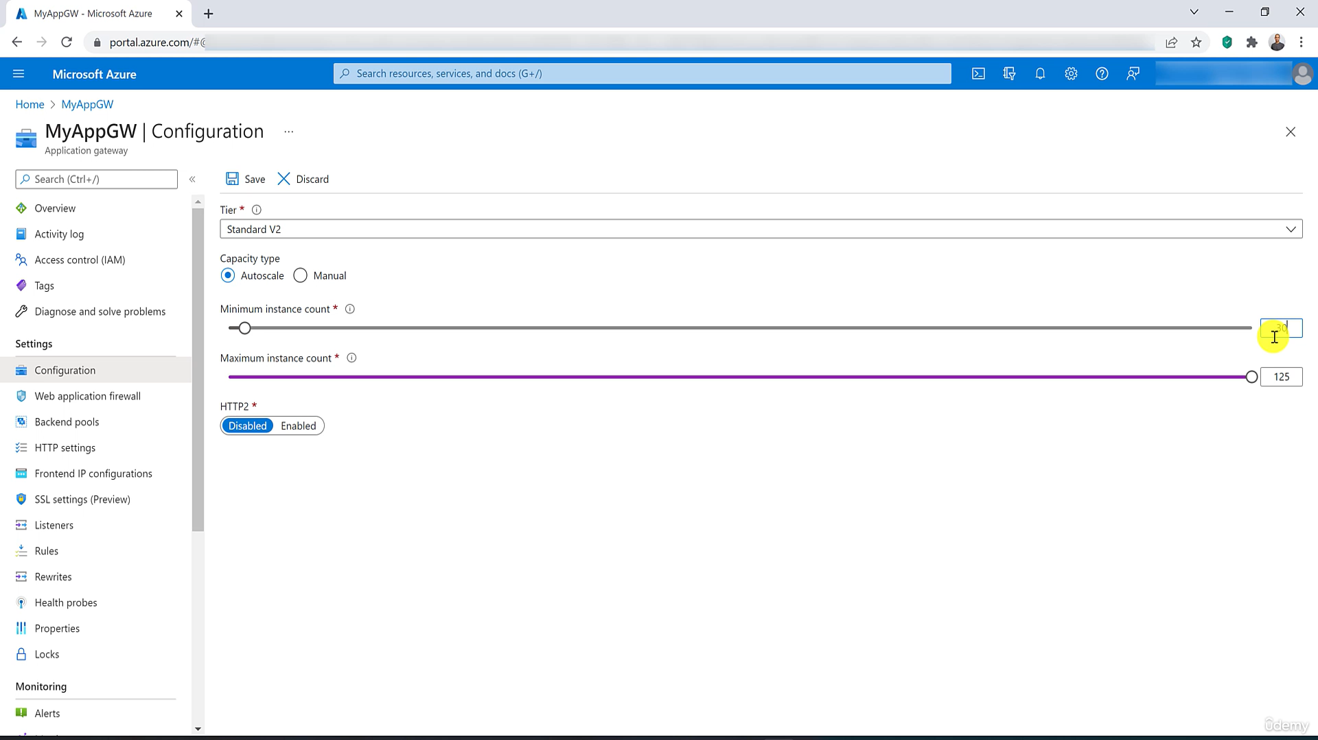

Slide 32
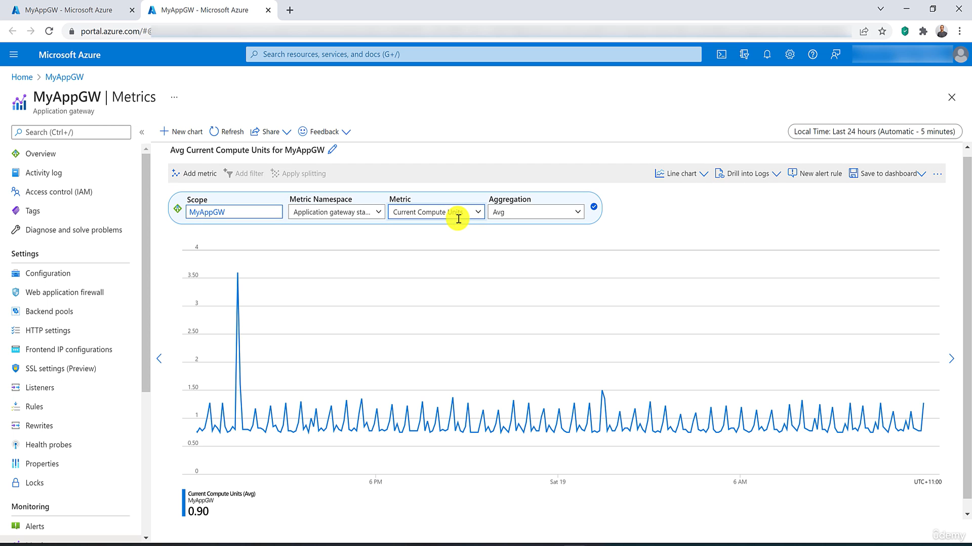

Slide 33
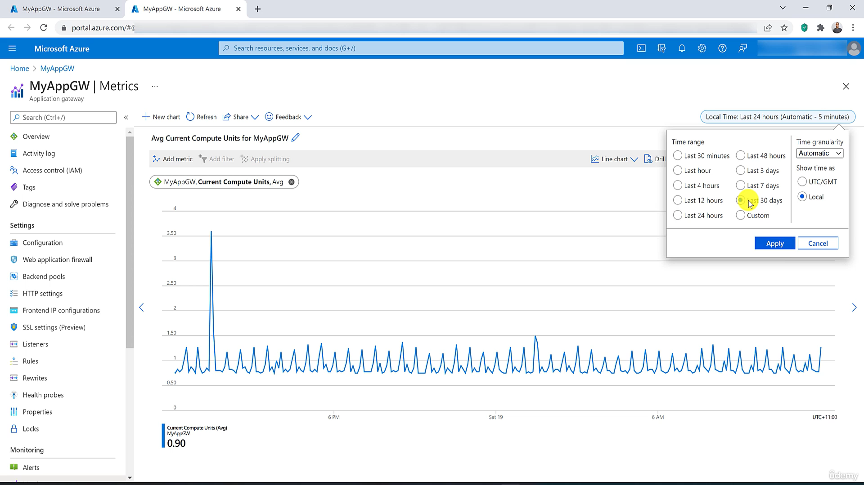

Slide 34
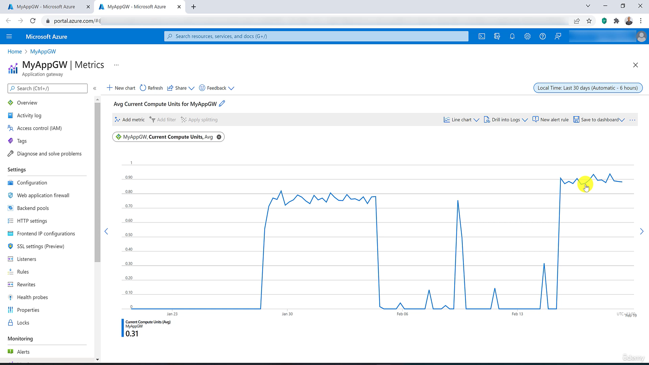

Slide 35
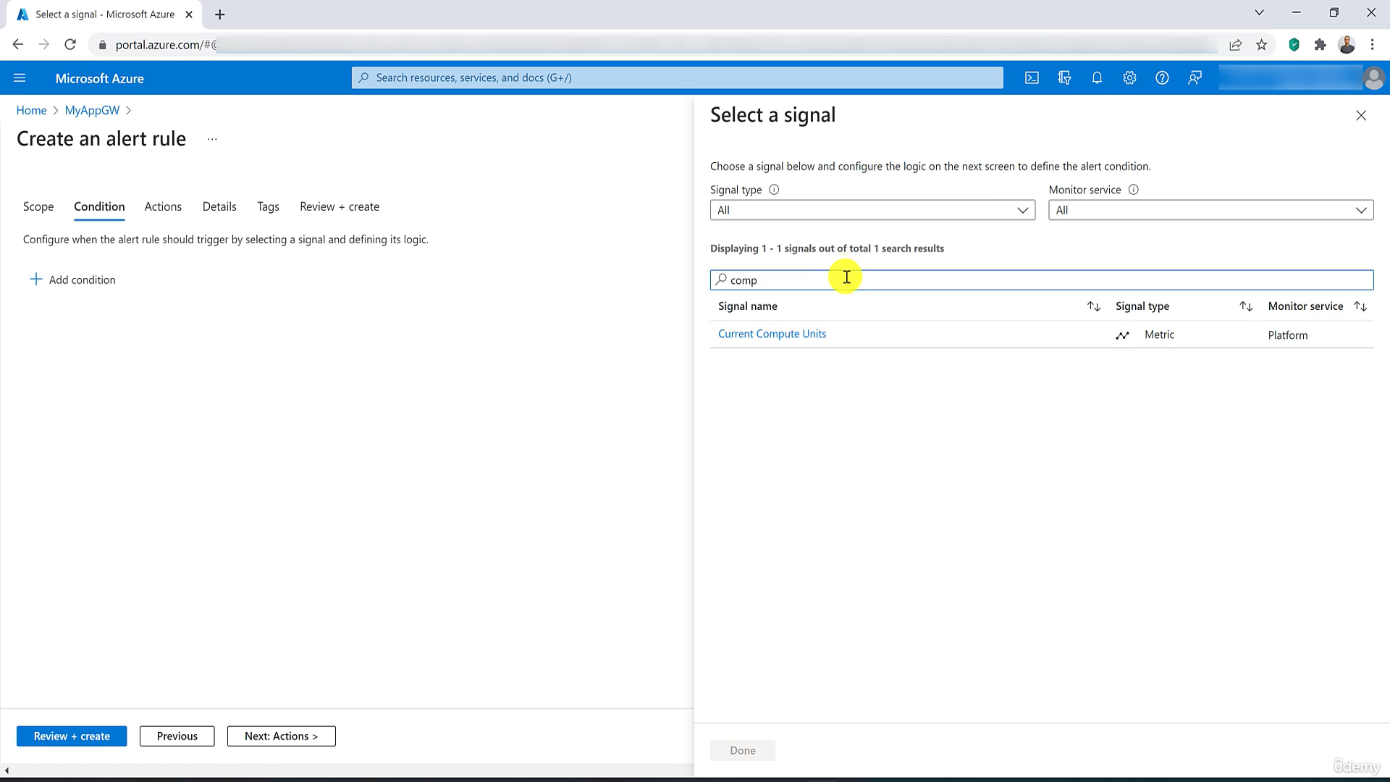

Slide 36
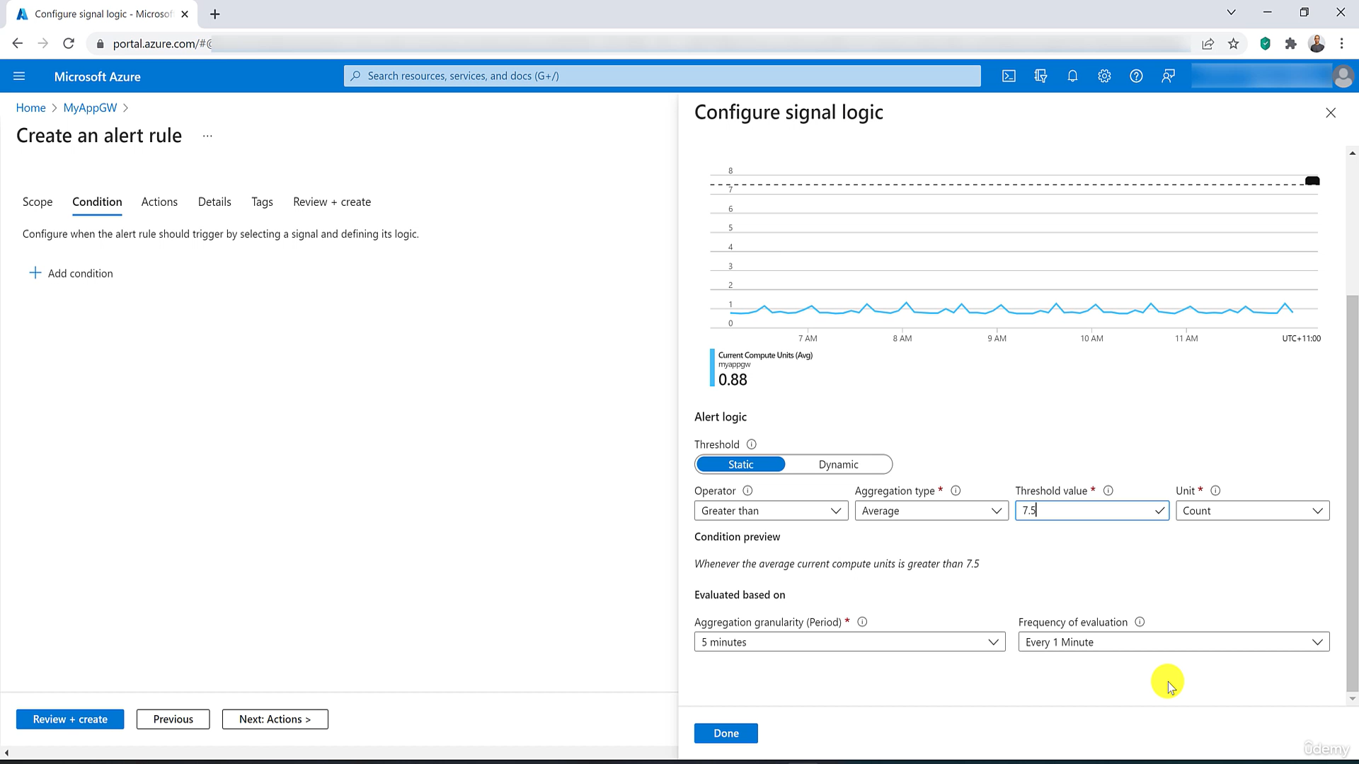

Slide 37
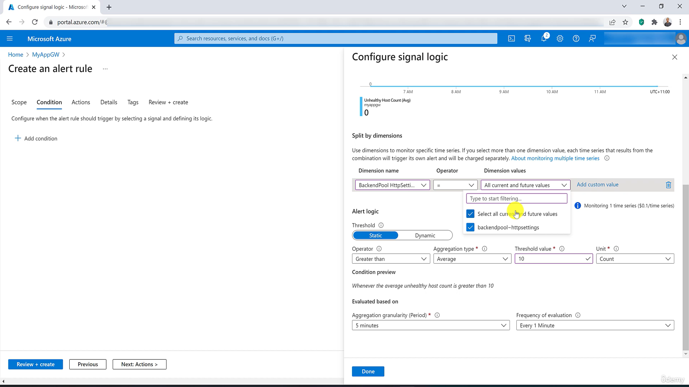

Slide 38
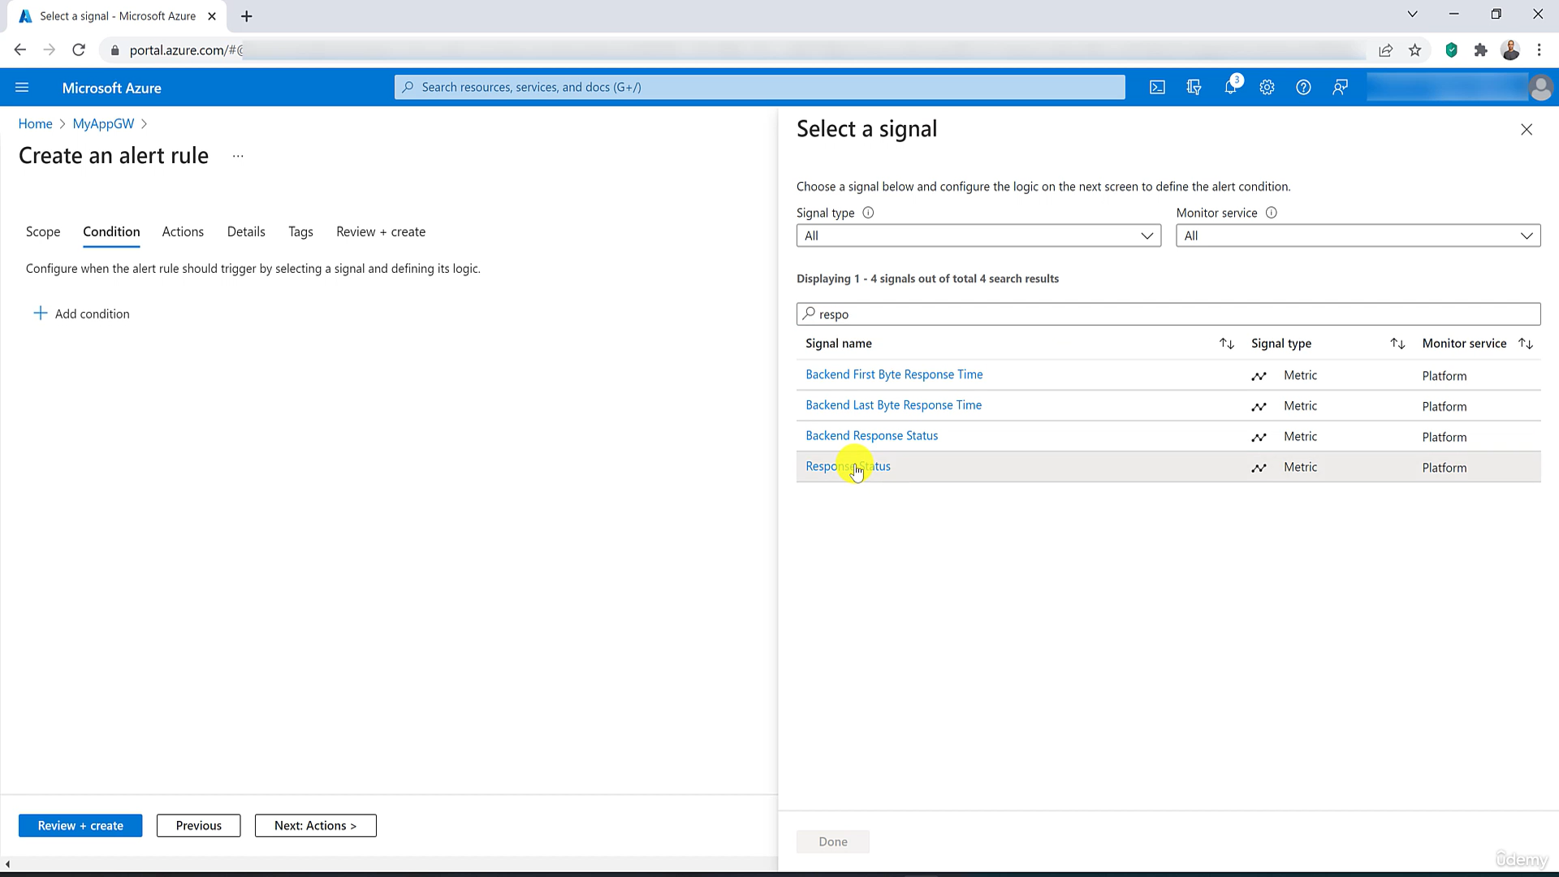

Slide 39
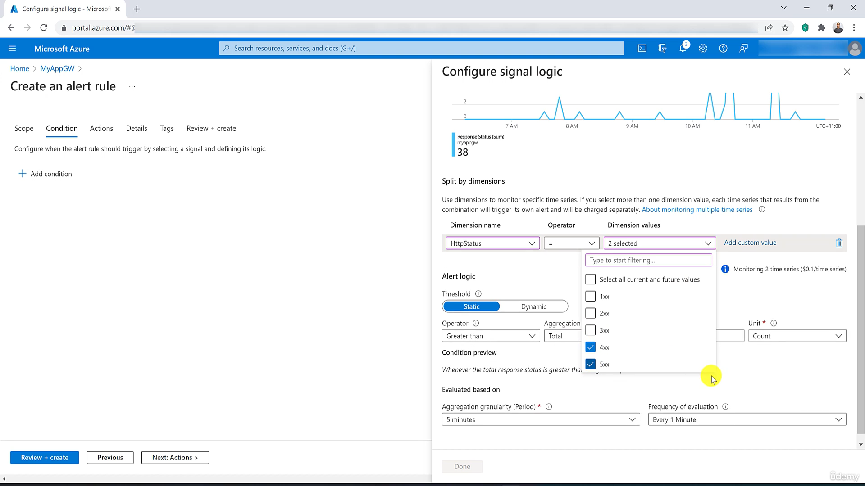

Slide 40
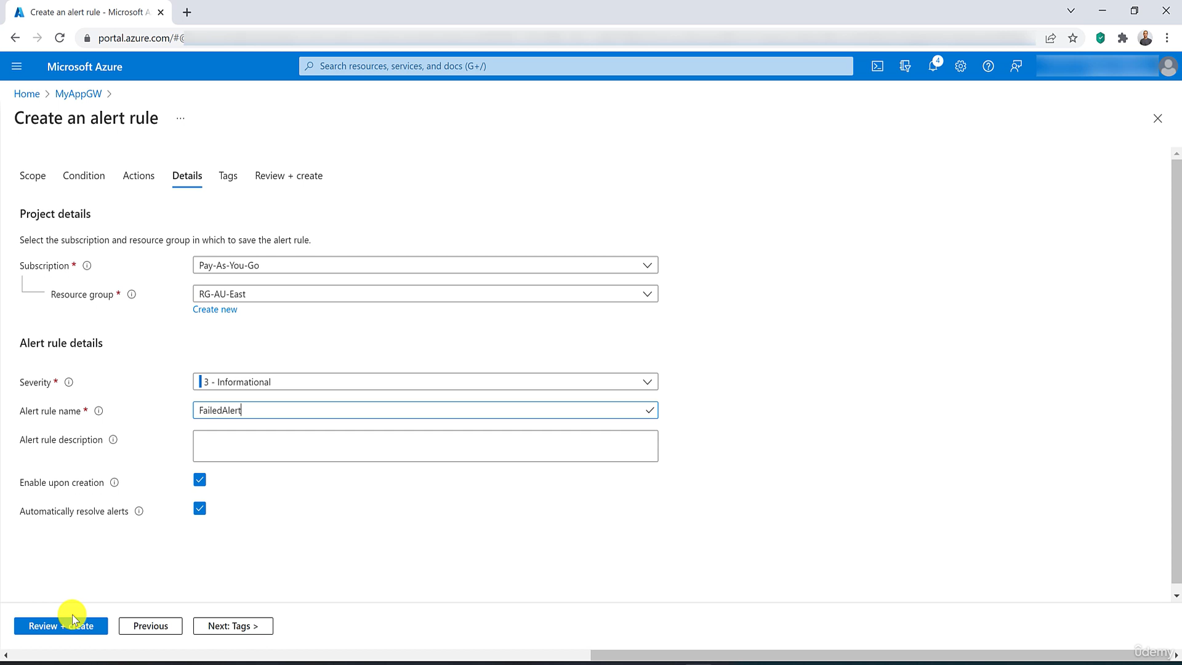

Slide 41
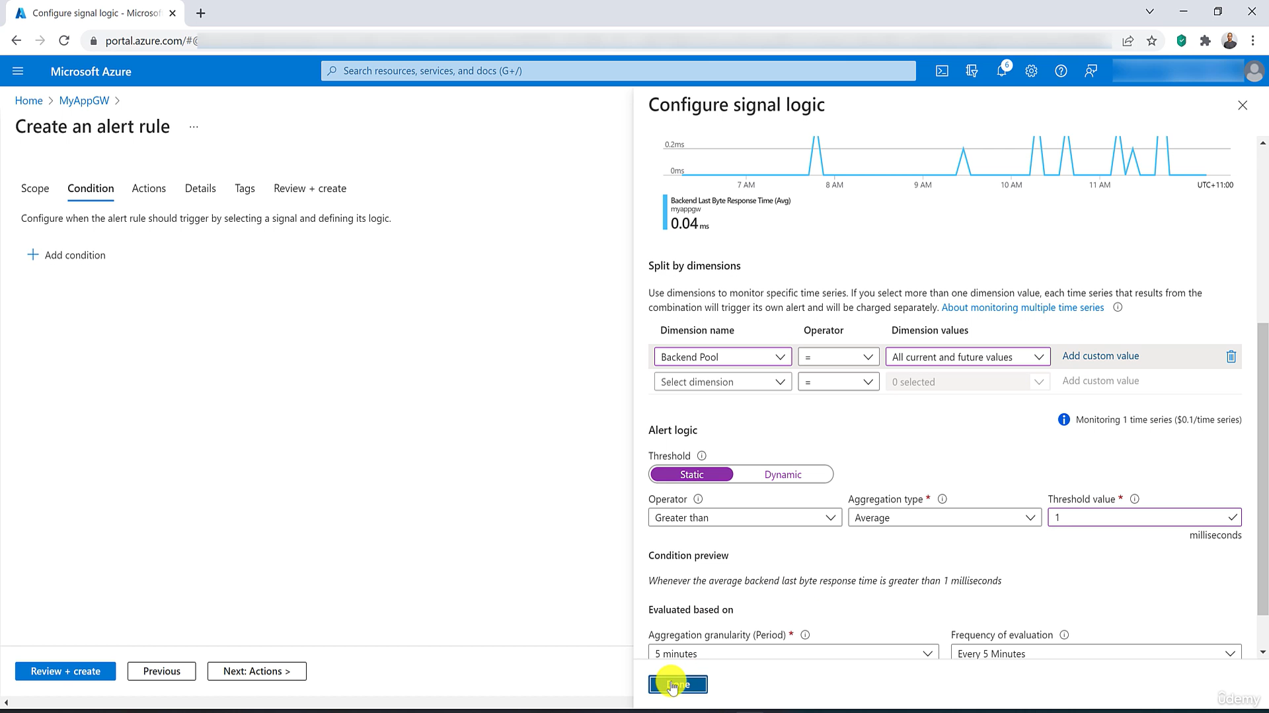

Slide 42
Azure Front Door
Architecture
Routing Decision
Routing Rule Matching
Backend Selection
Routing Methods
WAF (How and When ?) – Policy, Managed Rule, Custom Rules
Monitoring (Diagnostic Settings, Alerts, Metrics, Health Probs)

Slide 43
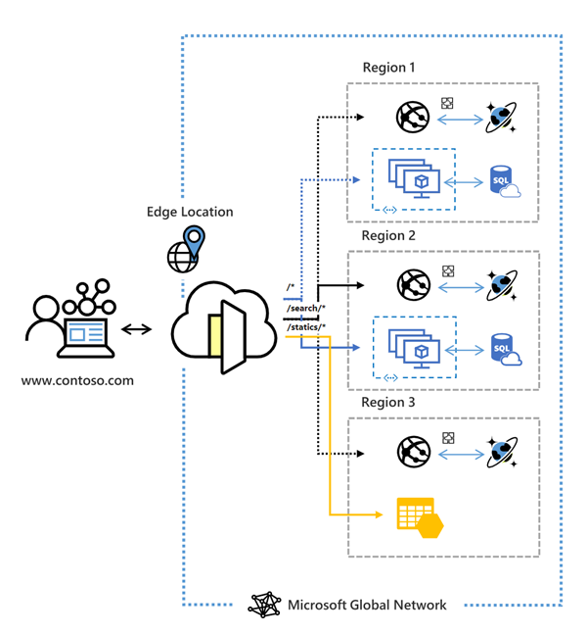
Notes:
https://learn.microsoft.com/en-us/azure/frontdoor/classic-overview

Slide 44
Key features included with Front Door (classic):
Accelerated application performance by using split TCP-based anycast protocol.
Intelligent health probe monitoring for backend resources.
URL-path based routing for requests.
Enables hosting of multiple websites for efficient application infrastructure.
Cookie-based session affinity.
SSL offloading and certificate management.
Define your own custom domain.
Application security with integrated Web Application Firewall (WAF).
Redirect HTTP traffic to HTTPS with URL redirect.
Custom forwarding path with URL rewrite.
Native support of end-to-end IPv6 connectivity and HTTP/2 protocol.

Slide 45
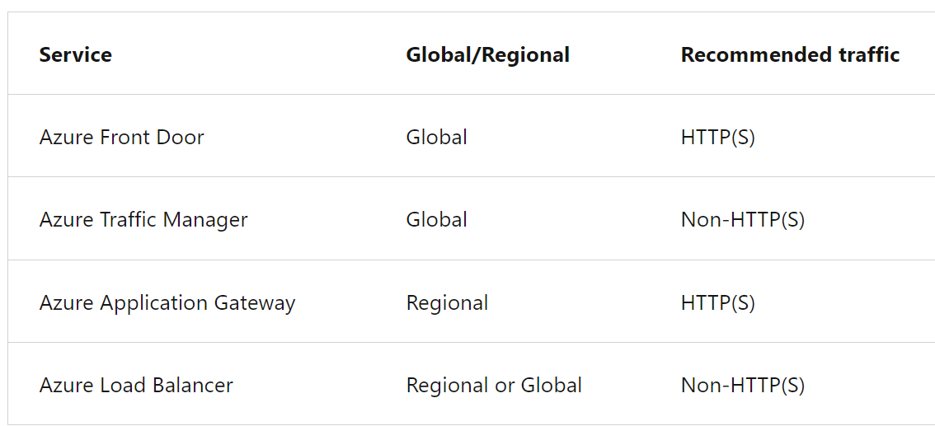


Slide 46


Slide 47


Slide 48

OWASP- Open Worldwide Application Security Project

Slide 49


Database Shading Pattern for Scaling Microservices Database Architecture

Slide 50
Azure service bus vs Azure Queue difference
 | Azure Service Bus | Azure Queue Storage
Use Case | You need advanced messaging features such as topics, subscriptions, and dead-lettering. Guaranteed message delivery, sessions, or transactions are important. You are building a more complex messaging architecture with publish-subscribe patterns. | You have simple queuing needs without the need for advanced messaging features. Cost efficiency is a primary concern. Messages are relatively small, and the 64 KB size limit is sufficient.
Advanced Messaging Features: | advanced messaging features such as publish-subscribe patterns, message sessions, advanced filtering, and transactional support Supports both "Brokered Messaging" (using topics and subscriptions) and "Message Queueing" (using queues) patterns. Provides more advanced messaging features like topics, subscriptions, dead-lettering, sessions, and scheduled message delivery. | simple, scalable, and cost-effective messaging solution for asynchronous communication between components of your application.

Slide 51
Message Sessions: | Supports message sessions for scenarios where messages need to be processed in a specific order or grouped together.
Topics and Subscriptions:
Transactional Support: | Supports distributed transactions spanning multiple messages and operations.
Dead-Lettering and Duplicate Detection: | Automatically moves messages that can't be processed to a separate dead-letter queue for troubleshooting. | No Dead-Letter Queue: Does not provide built-in support for dead-letter queues. Dead-lettering has to be implemented manually.
Peek-Lock Mechanism: | Uses a "peek-lock" mechanism where a message is only removed from the queue after it has been successfully processed.
Message Size: | Limited to smaller message sizes (up to 64 KB per message). | Azure Service Bus supports larger message sizes (up to 256 KB for standard tier, and up to 1 MB for the premium tier). it supports scenarios where message ordering, sessions, or transactions are important.

Slide 52
Reliability and Guaranteed Delivery: |  | Azure Service Bus provides features like transactions and message ordering, making it suitable for scenarios where guaranteed delivery and message order are critical.
 |  | Provides simple first-in-first-out (FIFO) message queueing capabilities.
 |  | Offers basic queuing features like message expiration, time-to-live (TTL), and invisibility timeout.
 | Supports multiple protocols including AMQP, MQTT, and HTTP/S.

Slide 53


Azure table storage vs Azure CosmosDB
Comparison | Azure Table Storage | Azure Cosmos DB
Data Model | NoSQL key-value store with a schema-less design stores data in tables, rows, and properties Each row has a primary key- | globally distributed NoSQL database service supports multiple data models, including document, key-value, graph, and column-family. It provides a schema-agnostic data model and allows you to store and query JSON documents.

Slide 54
Consistency | offers eventual consistency (This means that updates to data will eventually propagate across all replicas but may not be immediately consistent.) | provides various consistency levels, including strong consistency, bounded staleness, session consistency, and eventual consistency. You can choose the consistency level based on your application requirements.
Scalability | is designed for massive scale and can handle large volumes of structured data. It automatically partitions data to scale horizontally. | designed for global distribution and provides automatic scaling of throughput and storage across multiple regions. It allows you to scale both storage and throughput independently.
Querying | Azure Table Storage supports basic querying capabilities using partition and row keys. It does not support complex queries or secondary indexes. Azure Table Storage is limited to simple key-based retrieval and does not support complex queries or SQL-like syntax. | Azure Cosmos DB provides robust support for complex queries, including filtering, sorting, aggregations, and joins, using its SQL-like query language.
Indexing | Azure Table Storage does not offer indexing options beyond the partition and row keys, which limits its querying capabilities. | Azure Cosmos DB automatically indexes all properties, facilitating efficient query execution.
Global Distribution | Azure Table Storage supports replication within a single region or across multiple regions using geo-replication. | Azure Cosmos DB is globally distributed by default and allows you to replicate data across multiple Azure regions with a click of a button. It provides low-latency access to data from any region.

Slide 55
Pricing | Azure Table Storage offers a simple pricing model based on data storage and transactions (read/write/delete operations). | Azure Cosmos DB offers a more complex pricing model based on provisioned throughput, storage, and data transfer. It provides options for autoscaling throughput based on demand.
Use Case | Azure Table Storage is suitable for storing semi-structured data, logging data, sensor data, and simple key-value data. Azure Table Storage is a cost-effective solution for storing large volumes of structured data with simple querying requirements, | Cosmos DB is suitable for a wide range of use cases, including web and mobile applications, IoT applications, real-time analytics, gaming, and e-commerce applications that require low-latency, globally distributed data access. Azure Cosmos DB is a fully managed, globally distributed database service designed for building highly scalable and responsive applications with flexible data models and consistency levels. The choice between the two depends on your specific requirements for scalability, consistency, querying, and global distribution.

Slide 56
 | Table Storage: | Cosmos DB:
Schema Flexibility | Flexible schema within a table. | No rigid schema; supports dynamic schema and polymorphism.
Querying | Basic querying using partition and row keys. | Rich querying using SQL-like queries, supporting complex conditions and indexing.
Consistency | Eventual consistency. | Multiple consistency levels, including strong consistency.
Global Distribution: | Supports replication within a single region or across multiple regions. | Globally distributed by default, allowing data replication across multiple Azure regions.
 | If you have simple key-value storage needs with a flexible schema, Azure Table Storage may suffice. | If you need a more structured and feature-rich data model, especially for complex querying scenarios, Azure Cosmos DB may be a better fit.

Slide 57
Challenge, Strategy, POCs, STAR

Slide 58
Legacy System Integration: Integrating new .NET solutions with legacy systems may pose challenges due to technology stack differences and communication protocols.
Complex Business Logic: Handling intricate business logic and domain-specific requirements while maintaining code clarity and scalability.
Performance Bottlenecks: Identifying and resolving performance bottlenecks in .NET applications, databases, and external dependencies.
Security Vulnerabilities: Mitigating security risks such as SQL injection, cross-site scripting (XSS), and authentication/authorization flaws.
Data Management: Efficiently managing data storage, retrieval, and processing while ensuring data integrity and confidentiality.
Third-Party Dependencies: Evaluating and integrating third-party libraries, frameworks, and services into the solution architecture.
Scalability and Elasticity: Ensuring the solution can scale dynamically to handle increasing user loads and resource demands.
Cost Management: Optimizing infrastructure costs and resource utilization to ensure cost-effectiveness without compromising performance and scalability.

Slide 59
Assess Technical Requirements
Requirement ID | Requirement Description | Priority | Functional/Non-Functional | Status
REQ001 | User authentication | High | Functional | Draft
REQ002 | Role-based access control | High | Functional | Draft
REQ003 | Real-time data processing | High | Non-Functional | Draft
REQ004 | Integration with external systems | High | Functional | Draft
REQ005 | High availability and fault tolerance | High | Non-Functional | Draft
REQ006 | Scalability | High | Non-Functional | Draft
REQ007 | Data encryption in transit and at rest | High | Non-Functional | Draft
REQ008 | Logging and auditing | Medium | Non-Functional | Draft
REQ009 | Internationalization and localization | Medium | Non-Functional | Draft
REQ010 | Error handling and recovery | Medium | Non-Functional | Draft

Slide 60
Scalability & Flexibility - Autoscaling, Azure app service Deployment slot, AKS (Pod up down), Azure function, Azure sql database, Database Sharding, SQL Server Always on,
Reliability & Availability: Azure Availability Zones, Azure Regions, Availability sets, Fault & Update domain, Load balancing and clustering for services, Disaster Recovery solutions like backups and failover strategies
Security & Compliance -Azure Active Directory (Azure AD), Azure Key Vault, Azure Policy, Azure Security Center, Azure Sentinel, GDPR, HIPAA, Data encryption, Masking, access controls, Data encryption at rest and in transit, Firewall protection, Private end point, OWIN, OAUTH, OpenID, Identity Server 4, Azure Bastion, Microsoft sentinel, Microsoft Defender for cloud
cost & Integration : Azure Cost management, Azure logic app, Azure function, Azure API Management, (Service Bus, event grid, event hub), Storage(Blob, File, Queue, Table, Disk)
Performance & Latency(delay): Async, Retry, Circuit Breaker Pattern, Health check (CPU and Memory Utilization), Load Balancer(application Gateway, traffic manager, front door), CQRS, DDD, Mediator, Kafka (Onpremise), Ocelot API gateway( onpremise), Logging (kibana),
Support & Services: Azure Advisor, Azure Monitor, Azure Service Health
Portability: Azure Resource Manager (ARM) Templates, Azure Migrate, Azure Blueprint
Compatibility: with Azure DevOps CICD Pipeline, Azure arch, ubuntu server, Docker Images
Containerization & Orchestration : Docker & Kubernetes

Slide 61
Aspect | Description | Example
Scalability | Ability to handle increasing workload by efficiently allocating and distributing resources, such as compute power and storage, to accommodate growing demand. | Autoscaling of Azure App Service instances based on CPU utilization or incoming requests. Utilize Azure App Services for Web Apps or Azure Kubernetes Service (AKS) for containerized applications to easily scale horizontally based on demand. Implement autoscaling rules based on metrics like CPU utilization, incoming request count, or custom application metrics. Use Azure Load Balancer or Azure Traffic Manager to distribute traffic evenly across multiple instances of your application.
Flexibility | Capability to adapt and evolve the application architecture and components easily to meet changing business requirements or technology advancements. | Deployment of microservices architecture using Azure Kubernetes Service (AKS) to independently scale and update components. Adopt a microservices architecture, allowing independent deployment and scaling of individual components. Use containerization with Docker and Kubernetes to package and deploy applications consistently across different environments. Utilize Azure DevOps for CI/CD pipelines to automate build, test, and deployment processes, enabling rapid iteration and delivery.

Slide 62
Reliability | Ensuring consistent and dependable operation of the application, minimizing downtime and data loss through fault tolerance mechanisms and robust error handling strategies. | Implementation of redundant storage solutions like Azure Blob Storage with Geo-replication to ensure data availability across regions. Implement health checks and application monitoring using Azure Application Insights or similar tools to proactively detect and respond to issues. Design for fault tolerance by using retry policies, circuit breakers, and graceful degradation to handle transient failures. Leverage Azure Blob Storage for durable storage and enable geo-replication for redundancy and disaster recovery.
Availability | Guaranteeing that the application remains accessible and operational over time, achieving high uptime and providing seamless user experiences even during maintenance or failures. | Utilization of Azure Traffic Manager to distribute traffic across multiple Azure regions, enabling failover and load balancing for improved availability and performance. Deploy applications across multiple Azure regions for geographic redundancy and fault tolerance. Use Azure Traffic Manager for DNS-based global load balancing to route traffic to the nearest healthy endpoint. Implement Azure Application Gateway or Azure Front Door for HTTP load balancing, SSL termination, and application-level routing.

Slide 63


Slide 64


Slide 65




Slide 66


Slide 67


Slide 68
Caching

Slide 69



Caching
Feature | .NET Core Caching | Redis | Azure Cache for Redis
Type | In-memory caching within the application process. | Standalone distributed caching system. open-source, in-memory data store that can be self-hosted or deployed on various cloud platforms, including Azure. Self-hosted Redis requires you to manage the infrastructure yourself, including deployment, maintenance, and monitoring. | Managed distributed caching service on Azure. Microsoft Azure handles the infrastructure management tasks such as deployment, scaling, patching, and monitoring. Azure Cache for Redis seamlessly integrates with other Azure services and features, such as Azure Monitor, Azure Security Center, Azure Virtual Network, and Azure Active Directory. This integration simplifies management, monitoring, and security configuration within the Azure ecosystem.
Scalability | Limited to the resources of the application instance. | Highly scalable across multiple nodes. | Highly scalable with Azure infrastructure.
Persistence | In-memory cache, data is lost on application restart. | Supports both in-memory and persistent storage. | Supports both in-memory and persistent storage.
Data Structures | Basic key-value pairs with limited features. | Supports complex data structures like strings, lists, sets, etc. | Supports complex data structures like strings, lists, sets, etc.
Notes:
https://github.com/Jaydeep-007/AzureRedisCacheDemo/tree/master/AzureRedisCacheDemo
https://www.c-sharpcorner.com/article/azure-redis-cache-introduction-and-implementation-using-net-core-6-web-api/

Slide 70






Slide 71
Output Cache
Data Cache
[OutputCache(Duration = 60, VaryByParam = "Id")]
public ActionResult Index(int Id) {
var emps = from e in db.Employees where e.DeptID = Id
orderby e.ID
select e;
return View(emps);
}
private DataTable GetData()
{
DataTable data = Cache["data"] as DataTable;
if (data == null)
{
data = LoadDataFromDatabase();
}
return data;
}

Slide 72
Fragment caching

Slide 73
public IEnumerable<Product> GetProducts()
{
var cacheKey = "products";
var cache = MemoryCache.Default;
var products = cache.Get(cacheKey) as IEnumerable<Product>;
if (products == null)
{
// Retrieve products from the database
products = dbContext.Products.ToList();
var cachePolicy = new CacheItemPolicy
{
AbsoluteExpiration = DateTimeOffset.Now.AddMinutes(30)
};
cache.Add(cacheKey, products, cache
Policy);
}
return products;
}

Slide 74

Caching Data from External APIs

Slide 75


Slide 76


Slide 77


Slide 78

DDD, Clean Architecture ( Domain Layer, Application Layer, Infra Layer, Presentation layer)
Security-OAuth2/OpenID Connect for authentication, TLS/SSL for secure communication, Authentication(User Role, policy)
Logging(File beat, log stash, Elastic Search, Kibana)
Health check
Ubuntu Server
Docker
Artifact
Github(Tag)/ Azure Repo
PR request (Feature Branch🡪Master Branch)
Deploy on Azure VM/ AKS via Azure DevOps CICD Pipleline
gRPC HTTP2 /
Service Discovery – Consule
Resilience Patterns (Retry, Circuit Breaker Pattern)
Caching (Fragment, Distributed, Data Caching, Output cache, Donut)
DB
Every Service Flow
API
Ocelot/ Azure API Management/Amazon API Gateway
Product
Sub P1
Basket
Redis Cache
UI
ESB, EAI
SOA
Restull API
ESB
Kafka
RabbitMQ)
Azure Service Bus
Azure Queue, MSMQ
Azure Even Grid
Azure Event hub
Order
Sec Database
Read
(Identity Server)
Payment
Event Source
Notification

Slide 79
Azure, AWS, GCP

Slide 80
Category | Azure | AWS | GCP
Container Orchestration | Azure Kubernetes Service (AKS) | Amazon Elastic Kubernetes Service (EKS) | Google Kubernetes Engine (GKE)
Serverless Computing | Azure Functions | AWS Lambda | Cloud Functions
Container Management | Azure Service Fabric | Amazon Elastic Container Service (ECS) | Cloud Run
API Management | Azure API Management | Amazon API Gateway | Apigee API Platform
Database | Azure Cosmos DB | Amazon DynamoDB | Cloud Spanner
Service Mesh | Azure Service Fabric Mesh | AWS App Mesh | Istio (Can be used with GKE)
Monitoring & Logging | Azure Monitor, Azure Log Analytics | Amazon CloudWatch, AWS X-Ray | Stackdriver Monitoring & Logging
CI/CD Tools | Azure DevOps, Jenkins, GitLab CI/CD | AWS CodePipeline, Jenkins, GitLab CI/CD | Cloud Build, Jenkins, GitLab CI/CD
Infrastructure as Code | Azure Resource Manager (ARM), Terraform | AWS CloudFormation | Terraform, Deployment Manager
Integration | Azure Logic Apps, Azure Event Grid | Amazon SQS, Amazon SNS | Cloud Pub/Sub, Cloud Tasks

Slide 82
Compute | Azure Virtual Machines | Scalable computing capacity for various workloads.
 | Azure App Service | PaaS for hosting web apps, RESTful APIs, and mobile backends.
 | Azure Functions | Serverless compute service for running event-driven code without managing servers.
 | Azure Kubernetes Service (AKS) | Managed Kubernetes service for running containerized applications.
 | Azure Batch | Running large-scale parallel and high-performance computing (HPC) applications.
Storage | Azure Blob Storage | Object storage for unstructured data such as text or binary data.
 | Azure Files | Managed file shares accessible via SMB and NFS protocols.
 | Azure Disk Storage | High-performance managed disks for Azure VMs.
 | Azure Data Lake Storage | Scalable and secure data lake for high-performance analytics workloads.
 | Azure SQL Database | Fully managed relational database with built-in intelligence and scalability.
Network | Azure Virtual Network (VNet) | Private network in Azure to securely connect Azure resources to each other and to on-premises networks.
 | Azure Load Balancer | Distributes incoming network traffic across multiple VMs.
 | Azure Application Gateway | Application-level routing and load balancing with SSL termination and Web Application Firewall (WAF).
 | Azure VPN Gateway | Establishes secure connections between Azure VNets and on-premises networks.
 | Azure ExpressRoute | Dedicated private network connection to Azure, bypassing the public internet.
Security | Azure Security Center | Unified security management and threat protection across Azure resources.
 | Azure Active Directory (Azure AD) | Identity and access management for secure access to Azure resources.
 | Azure Key Vault | Securely store and manage sensitive information like secrets, keys, and certificates.
 | Azure Sentinel | Cloud-native SIEM (Security Information and Event Management) for intelligent security analytics and threat intelligence.
 | Azure DDoS Protection | Protects applications from Distributed Denial of Service (DDoS) attacks.
Backup and Recovery | Azure Backup | Simplified backup solution for backing up and restoring data from the Microsoft Azure cloud.
 | Azure Site Recovery | Disaster recovery service replicating workloads from a primary site to a secondary location.
 | Azure Archive Storage | Low-cost storage tier for archiving infrequently accessed data.
 | Azure Blob Storage - Lifecycle Management | Automates data movement between access tiers (hot, cool, and archive) based on changing access patterns.
Operational Services | Azure Monitor | Comprehensive solution for collecting, analyzing, and acting on telemetry from cloud and on-premises environments.
 | Azure Log Analytics | Advanced tools for querying and analyzing log data.
 | Azure Automation | Automation of repetitive tasks and orchestration of complex workflows.
 | Azure Cost Management | Provides tools for monitoring, allocating, and optimizing cloud costs.
 | Azure DevTest Labs | Enables quick creation and management of environments for development and testing
Other Services | Azure DevOps | Suite of development tools for planning, developing, and delivering software.
 | Azure Cognitive Services | Pre-built APIs for adding intelligent features such as vision, speech, language, and decision-making to applications.
 | Azure AI & Machine Learning | Platform and tools for building, training, and deploying machine learning models.
 | Azure IoT Hub | Cloud service for managing and securing IoT devices.
 | Azure Logic Apps | Service for automating workflows and integrating apps, data, and services.
 | Azure Event Grid | Fully managed event routing service for handling events from various sources.
 | Azure Event Hub
 | Azure Service Bus

Slide 83
 | Azure Cloud Advantage
 | Aspect | Azure Cloud | On-Premises
Cost | Initial Investment | No upfront hardware costs; pay-as-you-go model. | High initial capital expenditure for hardware, software, and infrastructure.
 | Operational Costs | Costs based on usage; pay-as-you-go or reserved instances for cost savings. | Ongoing costs for power, cooling, physical space, and maintenance of hardware and software.
 | Economies of Scale | Azure benefits from economies of scale, leading to lower per-unit costs. | Limited to the capacity and efficiency of the purchased hardware.
 | Cost Predictability | More predictable with options for reserved instances; scalable based on demand. | Requires forecasting and planning; potential for over-provisioning or under-provisioning.
Performance | Aspect | Azure Cloud | On-Premises
 | Infrastructure | Utilizes state-of-the-art, optimized hardware across global data centers. | Performance depends on the quality and age of the purchased hardware.
 | Latency | Low latency due to global data center presence and optimized network infrastructure. | Potentially higher latency, especially for geographically dispersed users.
 | Service Levels | Offers various performance tiers; allows selection of service levels based on needs. | Performance dependent on manual configuration and tuning of on-premises hardware.
 | Aspect | Azure Cloud | On-Premises
Scalability
 | Auto-Scaling | Supports auto-scaling for VMs, App Services, and databases; adjusts resources automatically based on demand. | Manual scaling requires purchasing new hardware or reconfiguring existing resources.
 | Elasticity | Scales up or down dynamically in real-time based on workload; flexible resource management. | Scaling involves forecasting, manual intervention, and potentially slow hardware upgrades.
 | Serverless | Azure Functions provide serverless computing, automatically scaling with demand and without server management. | Serverless equivalent requires manual management of physical servers and scaling infrastructure.
API Services | Aspect | Azure Cloud | On-Premises
 | Management | Azure API Management simplifies API management, scaling, and security with built-in features. | Requires manual setup and management of APIs; scaling and security need additional configurations.
 | Monitoring | Built-in monitoring and analytics tools provided by Azure for comprehensive API management. | Requires separate tools and manual setup for monitoring and analytics.
SQL Server | Aspect | Azure Cloud | On-Premises
 | Deployment | Azure SQL Database and SQL Managed Instance offer fully managed, scalable SQL Server instances. | | Requires manual setup, configuration, and maintenance of SQL Server hardware and software
 | Scaling | Automatic scaling options with built-in high availability and disaster recovery. | Manual scaling requires additional hardware investment; high availability needs to be configured manually.

Slide 84
Advantages of Cloud Solutions
Scalability: Cloud services allow you to scale resources up or down based on demand without needing significant upfront investments or long-term commitments.
Cost-Effectiveness: With cloud computing, you pay for what you use, reducing the need for large capital expenditures and ongoing maintenance costs.
Accessibility: Cloud solutions can be accessed from anywhere with an internet connection, which is beneficial for remote work and global collaboration.
Disaster Recovery and Backup: Cloud providers often offer robust disaster recovery and backup solutions, which can reduce the risk of data loss and downtime.
Automatic Updates: Cloud services usually include automatic updates and maintenance, ensuring that you have access to the latest features and security patches.
Flexibility: The cloud provides a variety of services and tools that can be quickly integrated, enabling faster development and deployment of applications.

Slide 85
On-Premises Servers:
1. Fixed Resources:
Scalability: Scaling up or down requires manual intervention and investment in new hardware, which can be slow and costly.
Cost: Requires significant upfront investment in hardware and ongoing maintenance costs.
2. Management Overhead:
Maintenance: Requires internal resources to manage, maintain, and update hardware and software.
Upgrades: Hardware upgrades can be disruptive and costly.
3. Control:
Customization: Offers greater control over hardware and software, which can be advantageous for specific compliance or security needs.
4. Performance:
Latency: For some applications, on-premises servers can offer lower latency and higher performance.

Slide 86
Azure (Cloud Solutions):
**1. Scalability:
Compute: Azure provides scalable compute options. You can increase or decrease virtual machines (VMs) based on load, and use auto-scaling to automatically adjust resources.
Storage: Azure Storage scales easily with demand, supporting both large and small storage needs without upfront provisioning.
Networking: Azure allows for dynamic scaling of networking resources to handle varying traffic loads.
**2. Cost Efficiency:
Pay-as-You-Go Model: You only pay for the resources you use, which can be more cost-effective than maintaining and upgrading on-premises hardware.
No Upfront Costs: Azure eliminates the need for significant upfront capital expenditure on hardware.
**3. On-Demand Resources:
VMs: You can deploy VMs with the right specs for your needs and scale up or down as required.
Serverless Computing (Azure Functions): Allows you to run code without provisioning or managing servers. You only pay for the compute time you consume, which is ideal for variable workloads.
AKS (Azure Kubernetes Service): Best for containerized applications with dynamic scaling of pods based on demand.
**4. High Availability and Zero Downtime:
Availability Zones: Azure offers multiple availability zones and regions, which can help ensure high availability and disaster recovery.
Load Balancing: Azure provides load balancing services to distribute traffic and minimize downtime.
**5. Automation and DevOps:
CI/CD Pipelines: Azure DevOps and GitHub Actions allow for streamlined continuous integration and continuous deployment (CI/CD), automating the deployment process and improving efficiency.
Infrastructure as Code (IaC): Tools like Azure Resource Manager (ARM) templates and Terraform enable automated deployment and management of resources.
**6. Energy and Resource Efficiency:
Optimized Data Centers: Azure operates energy-efficient data centers, leveraging advanced technologies to reduce power consumption and environmental impact.
Resource Utilization: Cloud environments typically have higher resource utilization rates compared to on-premises servers, reducing wasted capacity.
**7. Flexibility and Innovation:
Service Range: Azure offers a broad range of services and tools that can foster innovation, from AI and machine learning to advanced analytics and IoT.

Slide 87
Major Advantages of Cloud (Azure) Over On-Premises:
Scalability: Azure's ability to scale resources dynamically based on demand is more efficient than the static nature of on-premises hardware.
Cost Efficiency: The pay-as-you-go model can lead to significant cost savings compared to the capital expenditure and maintenance of on-premises systems.
High Availability: Azure provides built-in redundancy and high availability features that are often more complex and costly to implement on-premises.
Automation: CI/CD pipelines and automated infrastructure management streamline operations and reduce manual effort.
Energy Efficiency: Cloud providers like Azure invest in energy-efficient technologies, reducing the environmental impact compared to traditional data centers.

Slide 88
Exercise
https://learn.microsoft.com/en-us/training/browse/?terms=service%20bus
https://learn.microsoft.com/en-us/training/modules/introduction-to-azure-app-service/
AZ-204 Exam - Free Actual Q&As, Page 1 | ExamTopics
Microsoft Azure Fundamentals: Describe cloud concepts - Training | Microsoft Learn

Slide 89


Slide 90


Slide 91
Live Examples of Gen AI and Azure AI Services in Retail eCommerce
Scenario | Service/Tool | Description | Benefits
Automated Customer Support | Azure OpenAI Service + Azure Bot Service | Deploy a chatbot to handle FAQs, order tracking, and return processing. | Reduces customer support load, improves response time, and enhances customer satisfaction.
Personalized Product Recommendations | Azure Machine Learning + Azure Personalizer | Provide real-time product suggestions based on customer behavior and preferences. | Increases sales and customer engagement by offering relevant products.
Inventory Management & Demand Forecasting | Azure Machine Learning + Azure Synapse Analytics | Analyze historical sales data to forecast demand and optimize stock levels. | Prevents overstocking and stockouts, optimizing supply chain efficiency.
Receipt Scanning and Data Extraction | Azure Form Recognizer | Automate receipt scanning for quicker checkouts and returns, extracting details like price and product name. | Reduces manual errors, speeds up processing, and enhances customer experience.
Content Creation for Marketing | Azure OpenAI Service | Generate product descriptions, blog posts, and marketing content. | Saves time, ensures content consistency, and enables rapid updates for new products.
Fraud Detection and Prevention | Azure Machine Learning + Anomaly Detector | Detect unusual transaction patterns and flag potential fraudulent activities. | Enhances security, reduces fraud risk, and protects customer data.
Visual Search and Product Recognition | Azure Cognitive Services (Computer Vision) | Enable customers to search for products by uploading images. | Improves user experience by allowing visual product searches.
Real-Time Translation | Azure Cognitive Services (Translator) | Translate content to support multiple languages for international customers. | Expands global reach and makes the platform accessible to non-English speakers.

Slide 92
Automate Customer Support: Reduce the workload on customer service teams by handling common queries through chatbots.
Enhance Personalization: Use AI-driven insights to deliver tailored recommendations, increasing customer satisfaction and sales.
Optimize Operations: Automate data-intensive tasks such as receipt scanning and inventory management, leading to operational efficiency.
Strengthen Security: Implement AI to detect and prevent fraudulent activities, safeguarding customer data and transactions.
Expand Globally: Leverage real-time translation to cater to a broader audience, making the platform inclusive and globally competitive.

Slide 93
1. How do you approach designing a scalable and secure architecture for a high-traffic application?
Focus: Scalability, security, performance, and availability.Why they ask: This question evaluates your ability to design solutions that can handle growth and adhere to security best practices. Be prepared to discuss horizontal scaling, cloud-native solutions, and securing APIs.
2. Can you explain how you have handled system integration in a large-scale enterprise project?
Focus: Integration patterns, APIs, and middleware.Why they ask: Integration across legacy systems and modern platforms is a common challenge. Provide examples where you’ve used integration techniques such as message queues, API gateways, or microservices.
3. Describe a time when you had to refactor or migrate a monolithic application to a microservices architecture.
Focus: Migration strategy, challenges, and outcomes.Why they ask: They want to assess your experience with modernizing legacy systems and adopting microservices, including challenges like data consistency, orchestration, and service discovery.
4. How do you ensure compliance and governance in your architectural designs?
Focus: Governance, compliance, standards, and regulations.Why they ask: They want to see your understanding of regulatory frameworks (e.g., GDPR, HIPAA) and how you enforce compliance while designing solutions.
5. How do you handle non-functional requirements (e.g., performance, latency, availability) in your architecture?
Focus: Balancing NFRs with functional requirements.Why they ask: Architects must ensure systems meet critical performance and uptime expectations. Use examples to explain how you achieved high availability using solutions like caching, load balancing, or failover strategies.
6. Describe a challenging situation where you had conflicting stakeholder requirements. How did you resolve it?
Focus: Communication, collaboration, and problem-solving.Why they ask: Solution Architects often mediate between business and technical teams. Showcase your ability to balance priorities and negotiate solutions that align with business goals.
7. What is your approach to managing technical debt in an enterprise system?
Focus: Long-term maintainability and continuous improvement.Why they ask: They want to see how you prioritize improvements, reduce legacy dependencies, and align technical decisions with the business roadmap.
8. Can you walk us through your process for creating a roadmap for a new IT solution?
Focus: Strategic planning, milestones, and deliverables.Why they ask: This question evaluates your ability to balance immediate project needs with long-term business objectives, as well as your planning and prioritization skills.
9. How do you approach ensuring data consistency and reliability in a distributed architecture?
Focus: Eventual consistency, transactional integrity, and patterns like SAGA or CQRS.Why they ask: Distributed systems often deal with data synchronization challenges. They want to understand your experience with patterns to handle these challenges effectively.
10. Can you explain a major failure or challenge you faced in a project and how you resolved it?
Focus: Problem-solving, adaptability, and learning.Why they ask: They want to understand how you deal with unexpected challenges, mitigate risks, and ensure project success. Provide an example that highlights your proactive approach and collaboration.

Slide 94

1. How do you approach designing a scalable and secure architecture for a high-traffic application? Focus: Scalability, security, performance, and availability.Why they ask: This question evaluates your ability to design solutions that can handle growth and adhere to security best practices. Be prepared to discuss horizontal scaling, cloud-native solutions, and securing APIs.

Slide 95
Can you explain how you have handled system integration in a large-scale enterprise project?
Focus: Integration patterns, APIs, and middleware. Why they ask: Integration across legacy systems and modern platforms is a common challenge. Provide examples where you’ve used integration techniques such as message queues, API gateways, or microservices.

Slide 96
3. Describe a time when you had to refactor or migrate a monolithic application to a microservices architecture. Focus: Migration strategy, challenges, and outcomes.Why they ask: They want to assess your experience with modernizing legacy systems and adopting microservices, including challenges like data consistency, orchestration, and service discovery.
1. Migration Strategy: Assessment and Planning, Architecture Review, Domain-Driven Design (DDD), Prioritization
2. Incremental Migration: Strangler Fig Pattern: Data Migration: saga pattern with eventual consistency, API Gateway:
3. Service Discovery and Communication: Service Discovery, Inter-service Communication:
4. Testing and Monitoring: Continuous Integration/Continuous Delivery (CI/CD): using Azure DevOps to automate testing, building, and deployment. Monitoring and Observability: Azure Application Insights and Azure Monitor
Outcomes:
Scalability & Performance
Faster Development Cycles
Reduced Downtime
Business Flexibility:
Challenges Faced:
Data Consistency and Transactions:
Service Communication
Legacy System Coexistence:

Slide 97

4. How do you ensure compliance and governance in your architectural designs?
Focus: Governance, compliance, standards, and regulations.Why they ask: They want to see your understanding of regulatory frameworks (e.g., GDPR, HIPAA) and how you enforce compliance while designing solutions.

Slide 98
How do you handle non-functional requirements (e.g., performance, latency, availability) in your architecture?
Focus: Balancing NFRs with functional requirements. Why they ask: Architects must ensure systems meet critical performance and uptime expectations. Use examples to explain how you achieved high availability using solutions like caching, load balancing, or failover strategies.
1. Performance and Latency
To achieve optimal performance and reduce latency, I focus on the following strategies:
Caching:
Asynchronous Processing:
Content Delivery Networks (CDNs):
Optimizing Queries
2. Availability and High Availability
Ensuring that the system is available and reliable at all times requires implementing strategies for redundancy, failover, and fault tolerance:
Load Balancing:
Auto-Scaling:
Failover and Disaster Recovery:
Health Checks and Monitoring: Continuous monitoring with tools like Azure Monitor or Application Insights ensures that the system remains healthy.
3. Balancing NFRs with Functional Requirements
Scalability, Security vs Performance: Azure Key Vault for secure storage)
Redundancy vs Cost

Slide 99
Describe a challenging situation where you had conflicting stakeholder requirements. How did you resolve it?
Focus: Communication, collaboration, and problem-solving. Why they ask: Solution Architects often mediate between business and technical teams. Showcase your ability to balance priorities and negotiate solutions that align with business goals.
Situation: During an e-commerce project, the business team prioritized a fast launch for promotions, while the technical team focused on building a scalable and secure system, leading to conflicting timelines.
Action: I organized a joint meeting, used prioritization techniques to align goals, and proposed delivering an MVP for the business deadline while scheduling scalability improvements post-launch.
Result: The platform launched on time, meeting business goals, and the technical enhancements were implemented seamlessly after launch, ensuring both immediate and long-term success.
Key Point: Balancing stakeholder priorities with a phased approach ensured timely delivery without compromising quality.

Slide 100
7. What is your approach to managing technical debt in an enterprise system? Focus: Long-term maintainability and continuous improvement. Why they ask: They want to see how you prioritize improvements, reduce legacy dependencies, and align technical decisions with the business roadmap.
Approach to Managing Technical Debt:
Identify and Prioritize Debt:
Conduct regular code reviews, audits, and architectural assessments to identify areas with high technical debt.
Use tools like SonarQube to track code quality and maintain a backlog of technical debt items.
Categorize Debt:
Separate debt into critical (blocking scalability or security) and non-critical (refactoring or optimization).
Align debt prioritization with the business roadmap.
Allocate Time for Refactoring:
Use the "20/80 rule" by allocating 20% of each sprint to addressing technical debt while delivering new features.
Focus on areas with frequent changes to avoid compounding debt.
Automate Testing and CI/CD:
Implement unit tests, integration tests, and CI/CD pipelines to prevent new debt.
Enforce coding standards and static code analysis in the development process.
Educate and Align Teams:
Work with stakeholders to communicate the long-term benefits of reducing debt, such as lower costs and faster delivery.
Foster a culture of clean code and technical ownership within the team.
Approach to Managing Technical Debt:
Assess and Prioritize:
Regularly review the codebase to identify high-impact areas with technical debt.
Prioritize fixing debt that directly affects performance, scalability, or security.
Integrate into Sprints:
Allocate a dedicated percentage of sprint capacity to addressing technical debt alongside new feature development.
Focus on refactoring areas that are frequently updated to avoid accumulating more debt.
Proactive Practices:
Enforce coding standards, conduct regular peer reviews, and implement static code analysis tools.
Use CI/CD pipelines to catch issues early and prevent new debt from creeping in.
Communicate Value:
Explain the business impact of reducing technical debt, like fewer outages, faster releases, and lower maintenance costs.
Example: In a past project, the system's database queries caused performance bottlenecks. I prioritized query optimization and index management in sprints while ensuring minimal disruption to feature delivery. This reduced query latency by 50% and improved user satisfaction without delaying new releases.
Key Point: Managing technical debt requires balancing short-term delivery goals with long-term system health, ensuring maintainability and alignment with business priorities.

Slide 101
Can you walk us through your process for creating a roadmap for a new IT solution?
Focus: Strategic planning, milestones, and deliverables.Why they ask: This question evaluates your ability to balance immediate project needs with long-term business objectives, as well as your planning and prioritization skills.
Process for Creating a Roadmap for a New IT Solution:
Understand Business Objectives:
Begin by meeting with stakeholders to identify business goals, pain points, and success criteria.
Align the solution’s scope with both short-term needs and long-term objectives.
Gather Requirements:
Collaborate with technical and business teams to gather functional and non-functional requirements.
Prioritize features based on impact, feasibility, and urgency.
Define Key Milestones:
Break the solution into phases, such as proof of concept (POC), MVP, and full deployment.
Assign deliverables to each phase with clear timelines and measurable outcomes.
Plan Resources and Dependencies:
Identify required tools, technologies, and team roles.
Map dependencies, such as infrastructure readiness or third-party integrations, to avoid bottlenecks.
Build a Visual Roadmap:
Use tools like Azure DevOps Boards, Jira, or Gantt charts to create a clear and actionable roadmap.
Highlight critical milestones, dependencies, and deadlines.
Iterate and Communicate:
Regularly review the roadmap with stakeholders, adjusting it based on feedback and evolving priorities.
Maintain open communication to manage expectations and keep everyone aligned.
Example: While designing a microservices-based e-commerce platform, I created a roadmap with three phases:
POC: Built core services (user, product, and order management) to validate the architecture.
MVP: Added payment and inventory modules with basic scalability.
Full Deployment: Incorporated advanced features like real-time analytics, multi-region failover, and monitoring.

Slide 102
9. How do you approach ensuring data consistency and reliability in a distributed architecture?
Focus: Eventual consistency, transactional integrity, and patterns like SAGA or CQRS.Why they ask: Distributed systems often deal with data synchronization challenges. They want to understand your experience with patterns to handle these challenges effectively.
Approach to Ensuring Data Consistency and Reliability in Distributed Architecture:
Understand Consistency Requirements:
Identify where strong consistency (e.g., financial transactions) is critical versus where eventual consistency (e.g., inventory updates) is acceptable.
Engage stakeholders to balance business needs with system performance.
Use Appropriate Patterns:
SAGA Pattern: For distributed transactions, implement SAGA with compensating actions to maintain consistency across microservices.
CQRS (Command Query Responsibility Segregation): Separate read and write operations to optimize consistency and performance for complex systems.
Event Sourcing: Store state changes as events, allowing for replay and recovery to maintain data integrity.
Transaction Management:
Use distributed transaction managers or patterns like Outbox for atomic updates in event-driven systems.
Leverage idempotency in APIs and retries to handle failures gracefully.
Data Synchronization:
Use messaging systems like Azure Service Bus, Kafka, or RabbitMQ to propagate changes and ensure reliable delivery.
Implement mechanisms like event versioning to handle schema changes without breaking consumers.
Monitoring and Alerting:
Use tools like Application Insights, Elastic Stack, or Prometheus to track system health, detect anomalies, and quickly resolve inconsistencies.
Example: In an order management system, I used the SAGA pattern to handle distributed transactions between payment, inventory, and shipping microservices. Each step was implemented as an independent service, with compensating transactions for rollbacks. For consistency, we employed event sourcing and a message broker to synchronize states across services. This ensured reliability even during partial failures, reducing errors by 30%.

Slide 103
10. Can you explain a major failure or challenge you faced in a project and how you resolved it?
Focus: Problem-solving, adaptability, and learning.Why they ask: They want to understand how you deal with unexpected challenges, mitigate risks, and ensure project success. Provide an example that highlights your proactive approach and collaboration.
Action:
Immediate Fix: I collaborated with the team to implement temporary measures, including database indexing and horizontal scaling, to stabilize the system during the peak period.
Root Cause Analysis: After the event, we identified that the lack of scalability in the monolithic architecture was the main issue.
Long-Term Solution: I proposed migrating the order processing module to a microservices architecture. We broke it into smaller services (order validation, inventory check, payment processing), deployed them on Kubernetes, and introduced a message queue (Azure Service Bus) to handle asynchronous processing.
Collaboration: Worked closely with stakeholders to prioritize the migration plan and ensure minimal disruption to ongoing operations.
Result: The system's scalability improved significantly, reducing order processing time by 40%. During subsequent sales events, the system handled 3x the traffic without issues, enhancing customer satisfaction and business revenue.

